Slide 1


Topic 2: The Ecosystem Approach to Aquaculture and Spatial Planning
Masters Module
PLANNING AND MANAGING THE USE OF SPACE FOR AQUACULTURE
Paul Tett
SAMS
22 Feb2018
The materials used here have been assembled as part of the AquaSpace project
(Ecosystem Approach to making Space for Aquaculture, http://aquaspace-h2020.eu)
and has received funding from the European Union's Horizon 2020 Framework Programme
for Research and Innovation under grant agreement n° 633476.
They may be used under a Creative Commons Attribution-ShareAlike 4.0 International License, with attribution to the author
Horizon 2020

Slide 2
Introduction
These slides provide a short explanation of the Ecosystem Approach to Aquaculture and Marine Spatial Planning, as applied by the Aquaspace project
Details of references can be found in the accompanying text by Tett, P. (2017) The Ecosystem Approach to Aquaculture and Spatial Planning, LMC Working Paper, SAMS, Oban, Scotland.

Slide 3
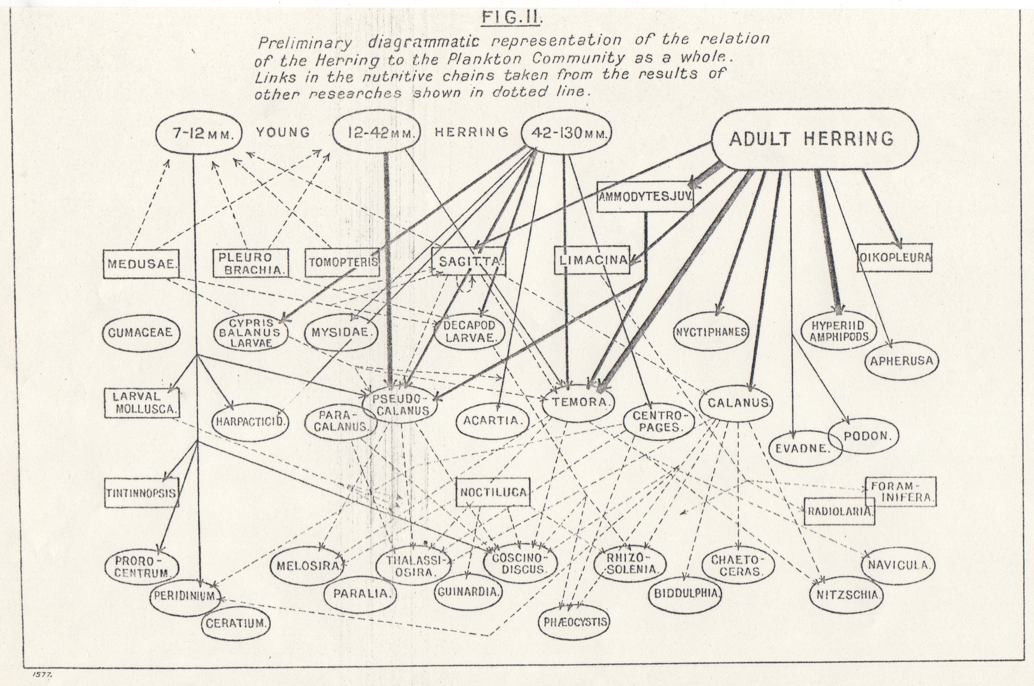
Ecosystem system composed of physical-chemical-biological processes active within a space-time unit of any magnitude, i.e. the biotic community plus its abiotic environment (Lindeman1942)
Illustration is the biotic community showing feeding relationships (i.e. a food web) from Hardy (1924)

Slide 4
Ecosystem Services
are`exports' from ecosystems to human economies that bring benefits to the people in these economies (Turner & Schaafsma, 2014)
Provisioning services include phytoplankton for cultivated shellfish
Regulating services include
Assimilative Capacity for waste from finfish farms

Slide 5
Ecosystem Approach to Aquaculture
The EAA is a sectoral implementation of the Ecosystem Approach of the Convention on Biological Diversity
The three principles (Aguilar-Manjarrez et al., 2017) of the EAA are:
  Aquaculture should be developed in the context of ecosystem functions and services (including biodiversity) with no degradation of these beyond their resilience;
  Development of aquaculture should improve human well-being with equity for all relevant stakeholders (e.g. access rights and fair share of income);
  Aquaculture should be developed in the context of other sectors, policies and goals, as appropriate.

Slide 6
Three ways to manage the distribution of ecosystem services by markets, hierarchies and collective arrangements (Tett & Sandberg, 2013)

Slide 7
Marine Spatial Planning
Marine Spatial Planning (MSP) (Ehler, 2014) is a public process of analyzing and allocating the spatial and temporal distribution of human activities in marine areas to achieve ecological, social and economic objectives that are usually specified through a political process. The components (Aguilar-Manjarrez, 2017) are
  National scoping – develop policies
  Zoning – identify areas for aquaculture
  Site Selection – EIA, licensing sites, social licence, etc
  Area management – e.g. for disease treatment

Slide 8
(Spatial) Scales
CSTT scales:
  Zone A, close to farm, water residence time 12 hours
  Zone B, water body, water residence time a few days
  Zone C, water residence time in weeks, providing boundary conditions for zone B

Slide 9
Adaptive Management
Adaptive management is (Ehler, 2014)
  the incorporation of a formal learning process into management actions. . . [i.e.] the integration of planning, implementation, monitoring and evaluation to provide a framework to systematically test assumptions, promote learning, and provide timely information for management decisions
It needs tools, defined (Galparsoro et al., 2017) as
  any legal instrument (laws, regulations, guidelines), process (such as stakeholder engagement), computer model application (such as GIS, or computer models to assess impacts of aquaculture), or any other hardware, software or set of instructions that can be used to help and support the purpose of making more high-quality space available for aquaculture, including the gathering, analysis and presentation of data to aid decision making in this context
Can be applied to site selection & management, to an industry (such as aquaculture) or to a spatial planning or governance process

Slide 10
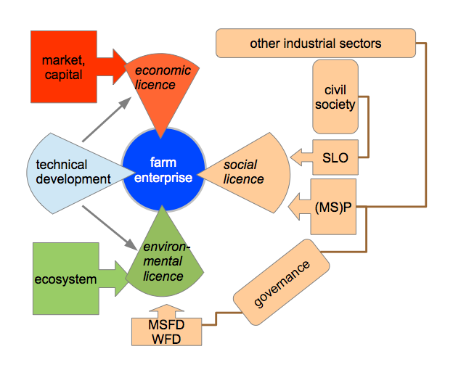
Licences and tools
Licences are switches that must by ‘ON’ for the enterprise to be viable; in some cases they are legal permissions
Social
Licence
tools
economic
tools
model
tools
Planning
tools
AquasSpace Tools

Slide 11
Summary: from the principles of the Ecosystem Approach to their operational application in Aquaculture
EA is Ecosystem Approach;
EAA is Ecosystem Approach to Aquaculture;
AM is Adaptive Management, making use of the monitoring feedback loop;
MSP is Marine Spatial Planning;
CBA is Cost-Benefit Analysis;
GIS is Geographic Information System

Slide 12

For more information about
the AquaSpace Masters module
and spatial planning toolbox,
visit our website:
www.aquaspace-h2020.eu
The materials used here have been assembled as part of the AquaSpace project
(Ecosystem Approach to making Space for Aquaculture, http://aquaspace-h2020.eu)
and has received funding from the European Union's Horizon 2020 Framework Programme
for Research and Innovation under grant agreement n° 633476.
Horizon 2020

