Slide 1

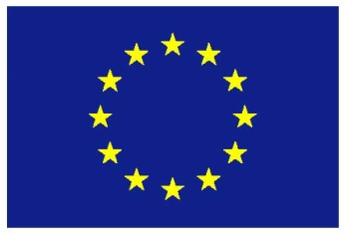
Unit 10: Social Investigation and Public Engagement Tools
Masters Module
PLANNING AND MANAGING THE USE OF SPACE FOR AQUACULTURE
Suzannah-Lynn Billing
SAMS
17 Jan 2018
The materials used here have been assembled as part of the AquaSpace project
(Ecosystem Approach to making Space for Aquaculture, http://aquaspace-h2020.eu)
and has received funding from the European Union's Horizon 2020 Framework Programme
for Research and Innovation under grant agreement n° 633476.
They may be used under a Creative Commons Attribution-ShareAlike 4.0 International License, with attribution to the author
Horizon 2020

Slide 2
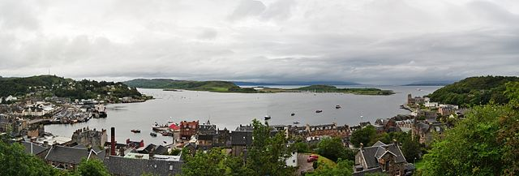
Contents
Introduction: Social issues related to space
Public and Stakeholder Engagement – Why do it?
Salmon farming in Scotland
Qualitative enquiry; why do people object to or support fish farms?
Methods and results
How does social licence to operate help us interpret the results?
Engagement and social licence to operate
Practical applications
Benefits and limitations of the qualitative approach and SLO

Slide 3
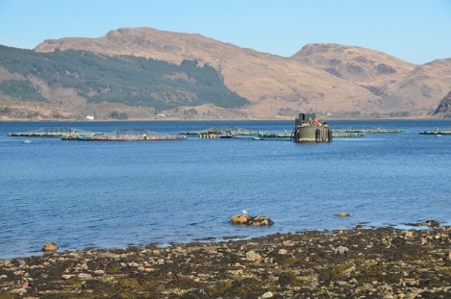
Introduction: Social issues related to space
Forestry
Fish farm
Someone’s home
Which should get priority, the fish farm, the forestry operation, or the person who lives in the house overlooking both?
What extent of disturbance to the environment/ view is ‘acceptable’ within society?
Is there a way that different industries, homeowners, and leisure seekers can operate in the same area? If so, what measures need to be taken to make it happen?
Notes:
Although our oceans and seas are large and often thought of as empty or devoid of human life, the reality is that our inshore waters around the globe are busy. In one area you might have several different types of operation which require the same space or are adjacent to each other. In many Scottish lochs there are several industries which rely on the marine environment, including;
Fishing
Marine tourism
Shipping and transpiration
Fish farming
Leisure activities (such as yatching, kayaking, diving)
Renewable energy
Our coastal environment does not end at the high-tide mark. Many of the industries listed above also require terrestrial developments such as;
Slipways, pontoons and harbours
Warehouses
Well-maintained road links
Onshore hatcheries
Offices
These industries have to interact with each other and the requirements of one might degrade the opportunities of another. A good example of this, is the argument around Acoustic Deterrent Devices which are used by fish farms to deter seals from damaging the nets around the cages and stealing the produce. The fish farms need to deter seals as damaged nets can release the farmed stock into the wild, which no-one wants, and reduces the monetary returns for the farm. The problem is that ADD use can exclude other echo-locating wildlife from the area, such as porpoises – not good for the wildlife tourism industry. This dynamic prompts social questions such as;
Which industry should get priority?
What extent of disturbance to wildlife is ‘acceptable’ within society?
Is there a way that both of these industries can operate in the same area? If so, what measures need to be taken?

Slide 4

Introduction: Social issues related to space
Visual impact is another area of spatial social issues which can influence the growth, or lack thereof, of the aquaculture industry.
Figure 1. Viewshed analysis. Source: O’Higgins (2017)
Notes:
Cumulative visual impact is another area of spatial social issues which can influence the growth, or lack thereof, of the aquaculture industry.
Figure 1. (O’Higgins 2017) was produced by modelling the views from every property on the West Coast of Scotland. The black dots represent where there are fish farms (both active and inactive). As you can see, there are very few areas marine activity is not visible from coastal areas.
The video (O’Higgings 2017) shows a 3d version of the model, but zoomed in to one area – Loch Linnhe and Loch Etive, in Argyll and Bute. The purple areas are where there is high visibility of fish farms from land and the blue areas is where there is limited visibility from land. If you would like to explore more of the viewshed analysis it is available online, courtesy of University College Cork, at: http://griffith.ucc.ie/demtools/
In a study which is yet to be published, the areas of most concern for those commenting on planning applications relating to the development of new finfish farms, the second most prevalent reason for objection was visual impact.
A couple of comments on one planning application stated that the objectors didn’t have anything against fish farming but felt like the sea/landscape was too ‘full’ given that there was also a wind farm on the hill adjacent to the proposed fish farm site.

Slide 5
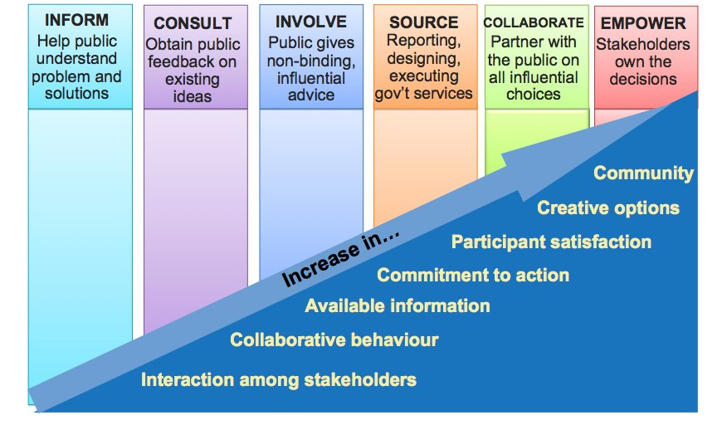
Public and Stakeholder Engagement – why do it?
Source: Mitchell and Haas (2011)
Notes:
Stakeholder engagement was a central concept in the Aquaspace project.
In order to address issues of space, it was first important to find out how they were manifest in the systems that our aquaculture industries were operating in and what solutions were already in circulation.
This meant that the project was able to address issues which were directly relevant to the industry and applicable to EU, national, and local governance systems.

Slide 6
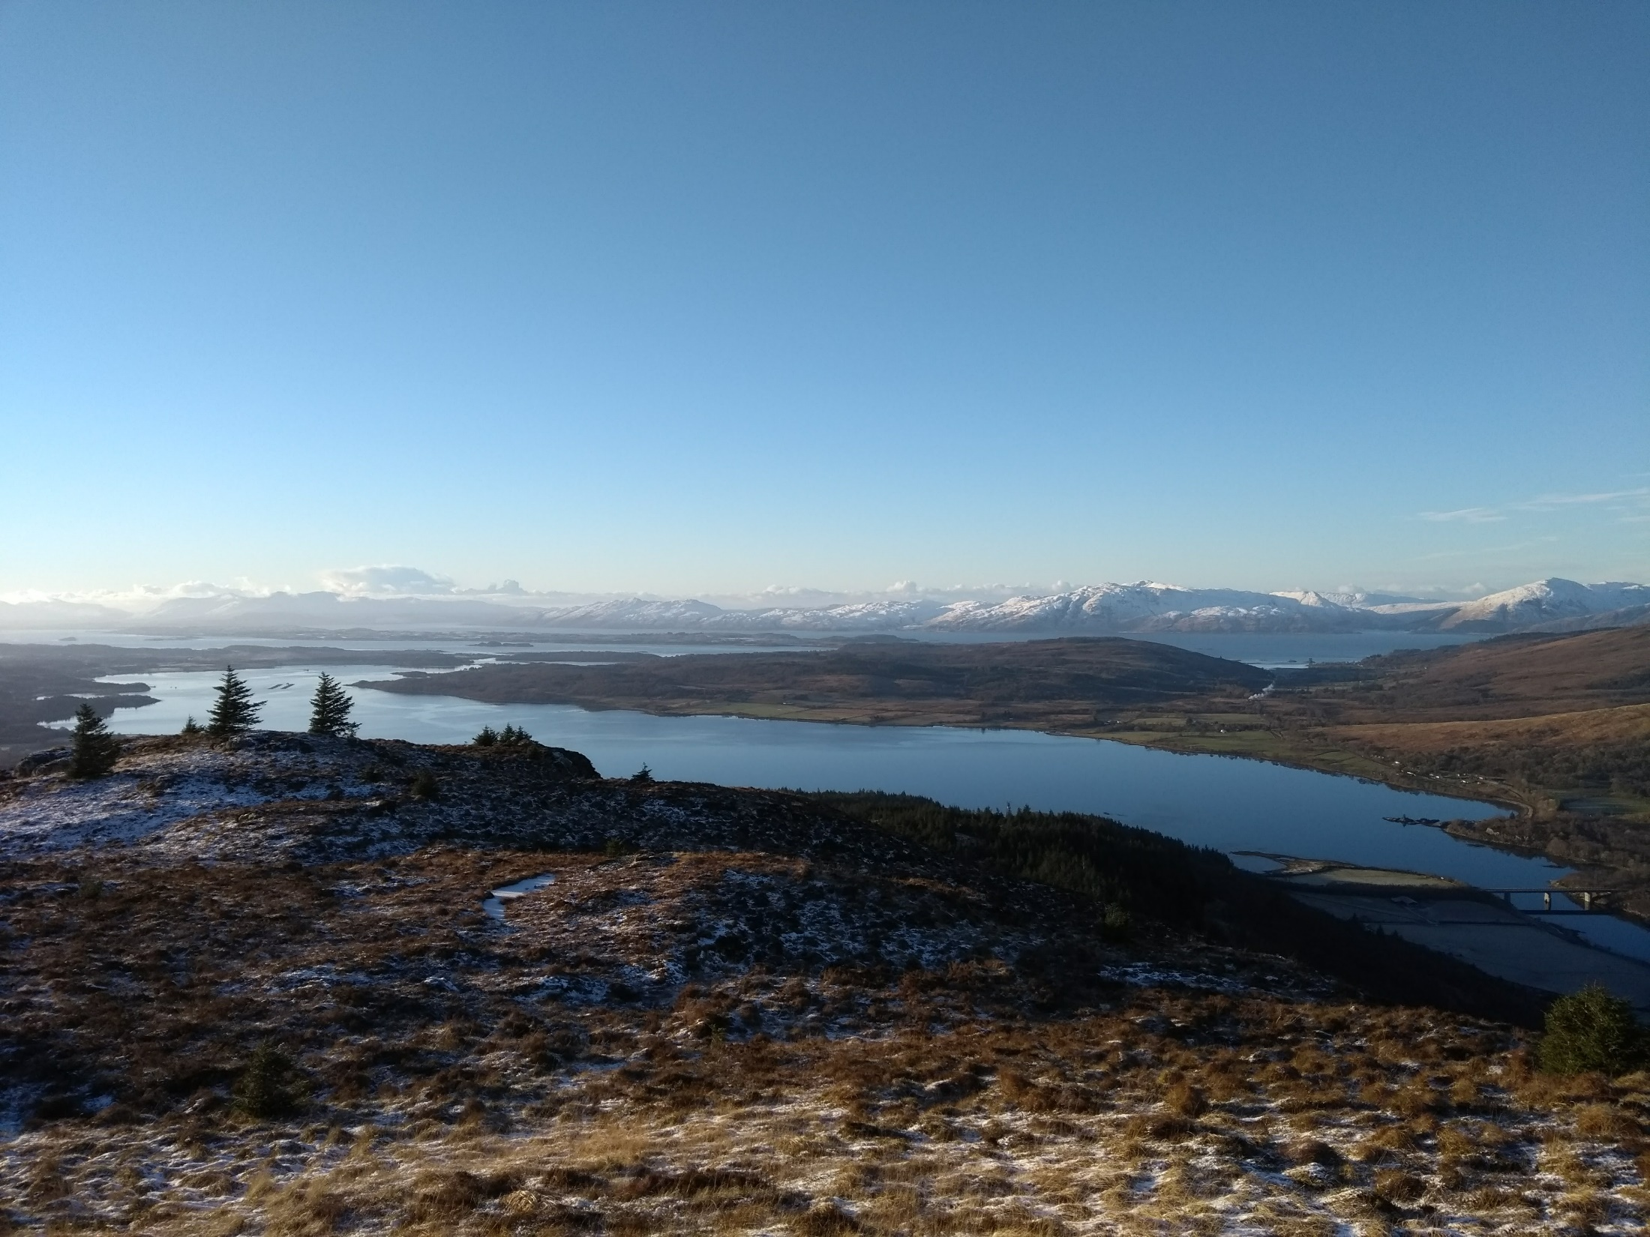
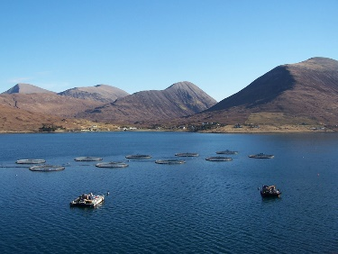
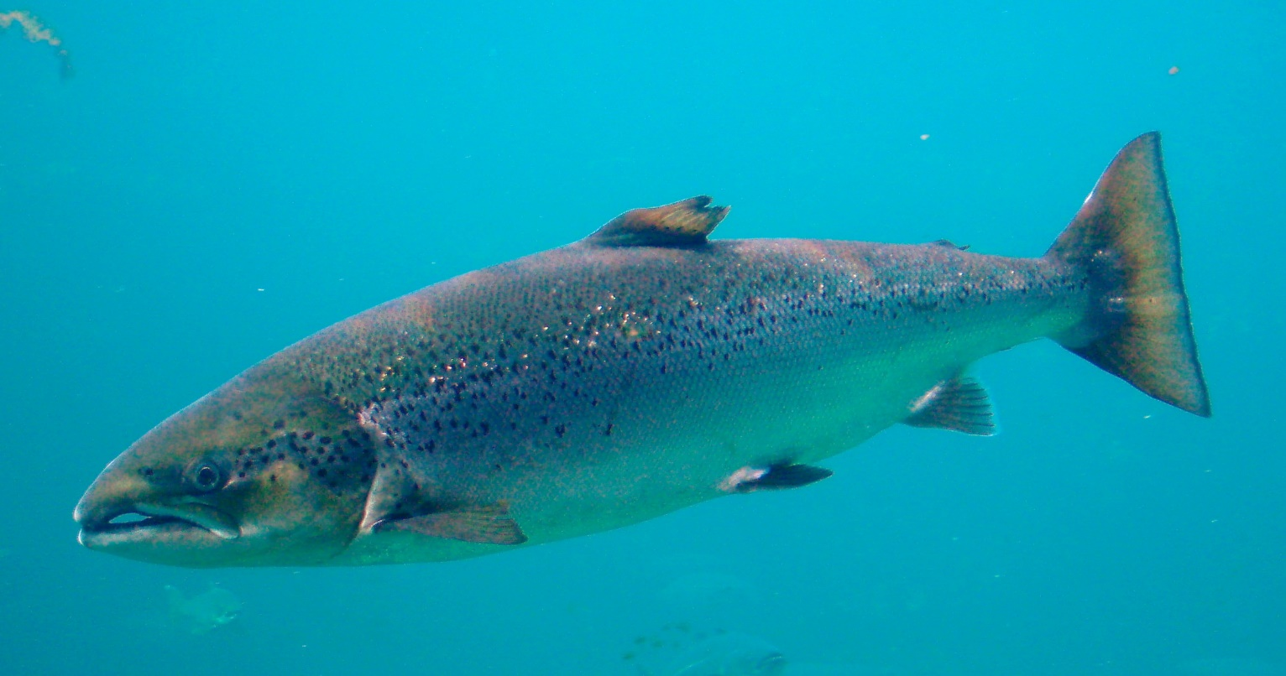
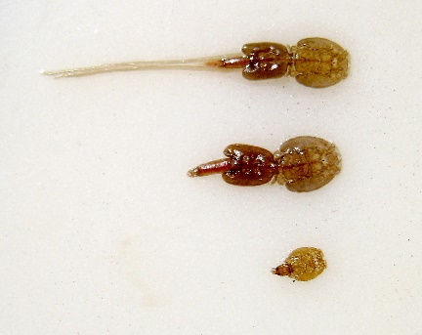
Salmon Farming in Scotland
Approximately 170,000 tonnes produced annually
Government growth strategy aimed at doubling this figure by 2030
Provides approximately 2,500 jobs to remote and rural areas
Biological issues mainly to do with sea lice caused an 11% reduction in production from 2016 to 2017 – but the value of the product increased
Source: The Scottish Government http://www.gov.scot/Topics/Statistics/Browse/Agriculture-Fisheries/TrendAquaculture
Notes:
In Scotland, the main aquaculture product is Atlantic Salmon.
Although the strategy to increase production makes sense economically, there are a few aspects which need to be ironed out before that can happen, not least the requirement to find more space for new farms.
One of the main issues with the production of Atlantic Salmon is that the stocking densities of the farms mean that the naturally occurring salmon louse is found in numbers which damage the fish and can cause early mortalities.
In order to control the sea lice, chemical treatments are used – these can be harmful to the environment – and many communities which rely on a well-managed marine environment for their livelihoods, or are concerned citizens, are concerned that the regulation of these chemicals is not good enough.
Anglers are also concerned that because wild fish salmon swim past the salmon farms, they are catching more lice than would be natural normally.
So on the one hand you have an industry which is incredibly beneficial for remote and rural areas, and on the other hand you have environmental and subsequent social impacts which are only slowly being addressed and more information becomes available.

Slide 7
Qualitative enquiry; Why do people object or support fish farms?
“It provides steady jobs for young folk. ”
“I trust that the SEPA [Scottish Environment Protection Agency] has done their job and therefore have no cause for concern.”
“It’s not something I want to see out of my living room window.”
Number of public comments that were analysed
Planning case | Date | Type of comment |  | Total number of comments
 |  | Objection | Support
Loch Striven | 2012 | 12 | 35 | 48
Loch Etive | 2013 | 589 | 218 | 812
Loch Etive | 2016 | 225 | 183 | 408
Isle of Shuna | 2014 | 29 | 17 | 49
Loch Slapin (pilot) | 2014 | 69 | 2 | 71
Total |  | 924 | 455 | 1388
“The practice doesn’t match the science – when that happens, I will stop objecting”
Notes:
One of the main issues which was brought up in a meeting with stakeholders on the West Coast of Scotland was issues with public perception and social licence (which will be covered later on in this presentation)
The stakeholders were unable to identify why there were issues with public perception as many of them spend money on Corporate Social Responsibility Strategies.
The question that was developed from the workshop was; What are the drivers for objecting or supporting planning applications for fish farms?
The study used publically available documents compiled by the planning authority in Argyll and Bute, Scotland
The documents contained the comments that the general public sent in about the formation of new finfish farms.

Slide 8
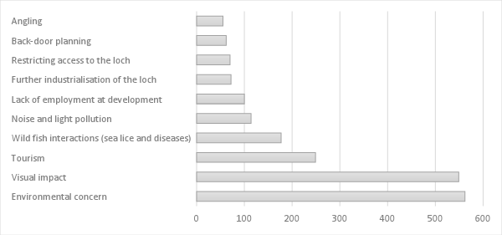
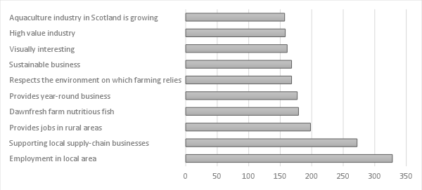
Method and Results
Reasons why people object to fish farms – environmental and visual impacts are the most cited reason.
Reasons why people support fish farms – direct employment and support of other businesses are the most cited.
Notes:
The 1388 comments on planning applications from fish farms were qualitatively coded for emergent themes. Practically, this required downloading, reading and sifting through the contents of the comments to come up with several overall themes. Many qualitative researchers choose to use qualitative coding software (QSR Nvivo is an example), however as the comments were all image files, excel was used for recording the themes.
Once the analysis was complete it became evident that there were four topics that people were talking the most about. For the objectors this was ‘environmental concern’ and ‘visual impact’ and for the supporters it was ‘supporting local supply-chain businesses’ and ‘employment in the local area’

Slide 9
How does social licence to operate help us interpret the results?
“The company [SSC] has a sponsorship programme and is willing to take part in and engage with communities.”
Good corporate social practice wins support
Trust, communication, and involvement are essential for SLO.
“At no stage…has the developer tried to discuss or address the severe impacts with which its plan threaten [Estate]… Dawnfresh admits that [Estate] will suffer the worst impact in terms of the visual intrusion of the farm but the developer has not even bothered to talk to me about this”
Poor corporate social practice creates conflict and objections
Notes:
Trust, communication and involvement are all essential components for SLO (Moffat and Zhang, 2014).
The blue speech bubble provides an example of where someone is in support of a new finfish farm because of the behaviour of the company applying. They trust that the company will be have as it has always done – in a neighbourly fashion.
The orange bubble provides an example of where someone is objecting to a new finfish farm because of the visual impact, but the behaviour of the company is evidently part of the issue.
This is a good example of where the behaviour of the companies in question directly impacts the actions that people take – in one case to support and in one case to object to further development.
SLO provides a good framework for understanding why some companies are seen as better than others in the eyes of local communities and sometimes the general public.

Slide 10

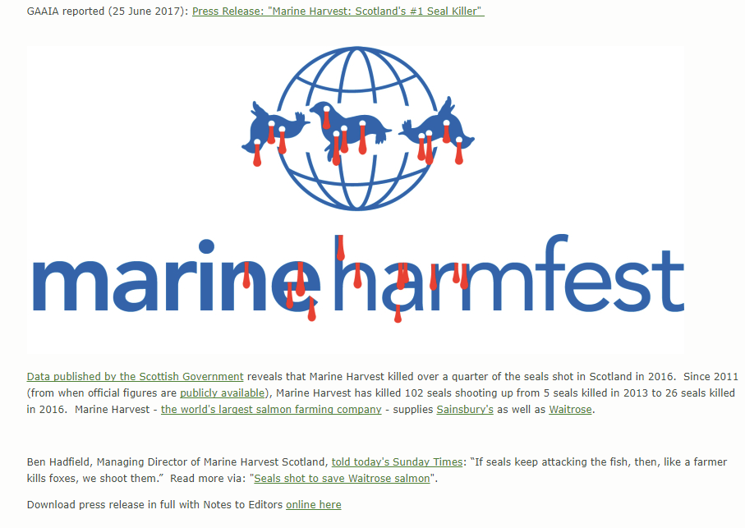
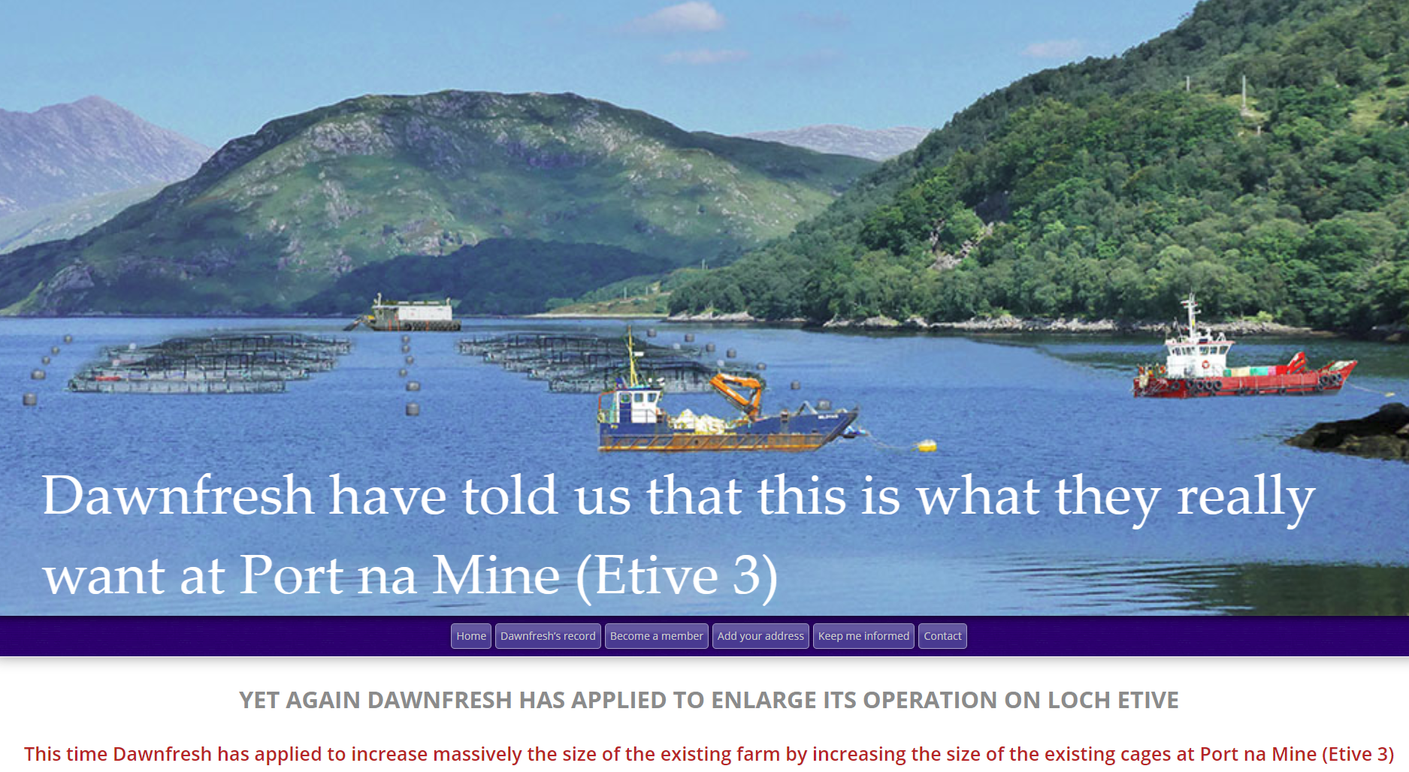
Engagement and social licence to operate
Notes:
Engagement and how it’s done plays a central role in the negotiation for SLO.
In research study that we are looking at there were different engagement strategies used by NGO’s and individuals and governmental agencies and aquaculture operators.
The NGOs and individuals use different tactics to aquaculture operators and government agencies when communicating with the public.
The picture on the right is from an NGO who campaigns against industrial aquaculture. They have a mailing list which the public can sign up for and receive information on about the environmental damage that aquaculture does, particular salmon farming.
The picture at the bottom is from another NGO who’s focus is very local. This NGO also has a mailing list, membership and provides advice on how to object to fish farming in the locality of loch Etive, Scotland. This NGO also provided every household in the area with flyers with this picture, urging people to object.
Bottom figure source: http://lochetive.org/
Right figure source: http://www.gaaia.org/

Slide 11
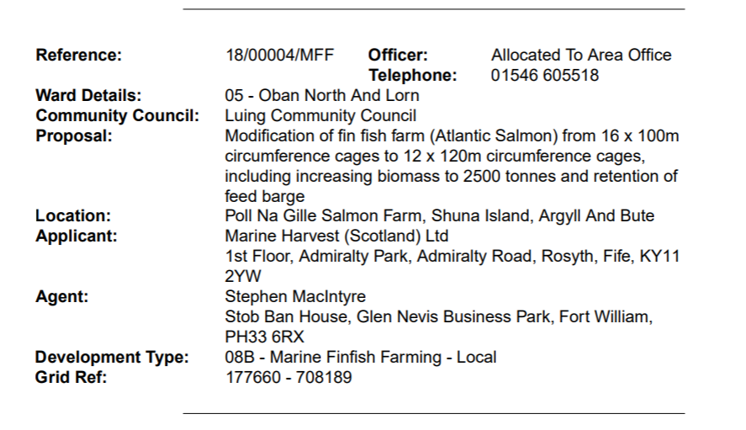
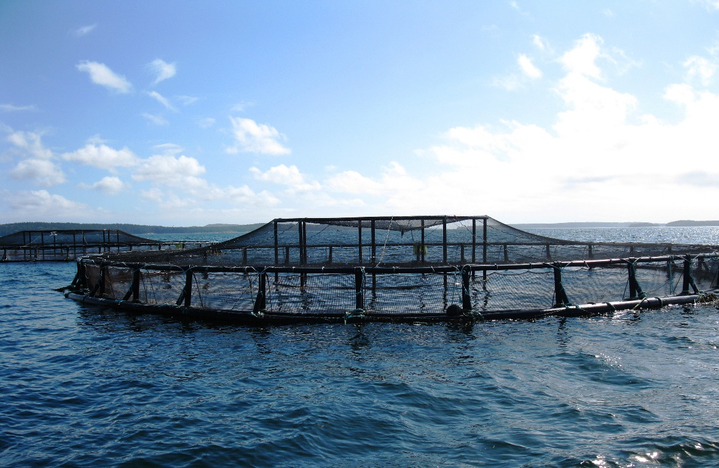
Engagement and social licence to operate
Notes:
The aquaculture operators and government agencies (such as the local Council) had very different strategies for communication with the public about fishfarm developments.
The Council has legal obligations and limited resources which means that their engagement strategies are strict.
The picture on the right shows a notification of a planning application – do you think most people will read this?
The aquaculture companies hold pre-planning workshops which show the details of the sites – which are copyright – so aren’t shown here.
The visual appearance of the information provided by the Council and the aquaculture companies isn’t great. In addition the communities and the general public have to make an effort to find the information rather than having it delivered directly to their doors.

Slide 12

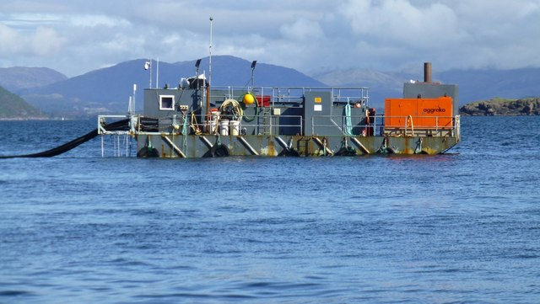
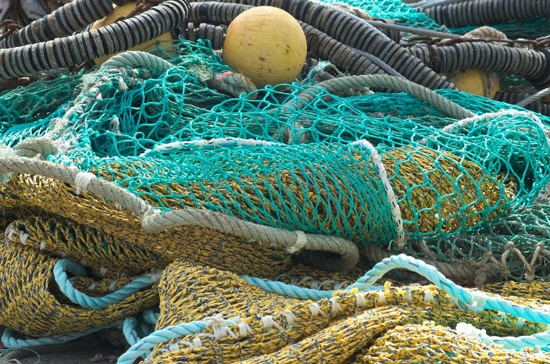
Practical applications
Effective communication strategy
Ensure that simple measures are taken to reduce visual impacts such as keeping sites clean and tidy.
Notes:
The two different types of engagement strategies that are used by the NGOs (and individuals) and the aquaculture operators and Council means that the NGO information might have a wider reach.
The behaviour of the companies directly impacts SLO, and there are relatively simple measures which can improve corporate-community relations including;
Developing an effective communication strategy
Developing a relationship with local communities through community councils
Talk to those who will evidently be negatively impacted by the developments
Ensure that simple measures are taken to reduce visual impacts such as ensuring that sites are clean and tidy.

Slide 13
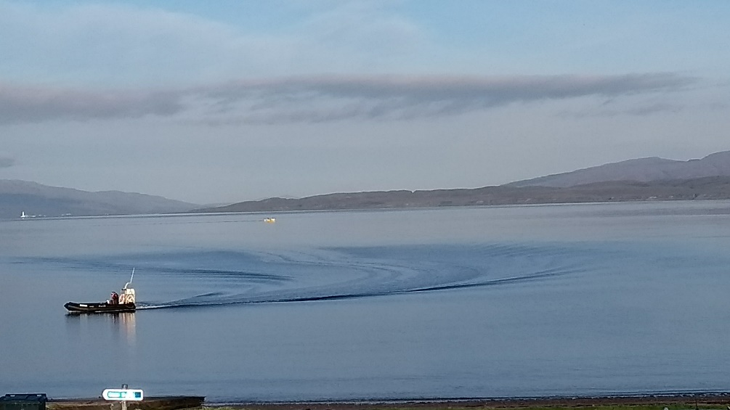
Benefits and limitations of this approach
Benefits
Limitations
The benefit of this type of qualitative research is that it provides evidence for why there are social issues around expanding aquaculture.
Low-cost
Provides useable results in a format that is well-understood by the industry (SLO)
Can identify areas where there are ‘quick wins’ for industry – such as tidying up sites
Can identify long-term issues which will need to be addressed
Requires a lot of time
Requires specialist training
Requires more research to understand the role of information in SLO as this is currently not understood

Slide 14

For more information about
the AquaSpace Masters module
and spatial planning toolbox,
visit our website:
www.aquaspace-h2020.eu
The materials used here have been assembled as part of the AquaSpace project
(Ecosystem Approach to making Space for Aquaculture, http://aquaspace-h2020.eu)
and has received funding from the European Union's Horizon 2020 Framework Programme
for Research and Innovation under grant agreement n° 633476.
Horizon 2020

