Slide 1
Topic 3: Aquaculture zoning, site selection and area management under the EAA
Masters Module
PLANNING AND MANAGING THE USE OF SPACE FOR AQUACULTURE
Illustrations provided by FAO
Assembled by Paul Tett
SAMS
25 April 2018
The materials used here have been assembled as part of the AquaSpace project (Ecosystem Approach to making Space for Aquaculture, http://aquaspace-h2020.eu) and has received funding from the European Union's Horizon 2020 Framework Programme for Research and Innovation under grant agreement n° 633476.
They may be used under a Creative Commons Attribution-ShareAlike 4.0 International License, with attribution to the author
Horizon 2020

Slide 2
Aquaculture Zoning, site selection and area management under the ecosystem approach to aquaculture: a handbook
Illustrations from Report ACS18071 part 1
José Aguilar-Manjarrez & Doris Soto (FAO)
Randall Brummett (World Bank)
2017

Slide 3
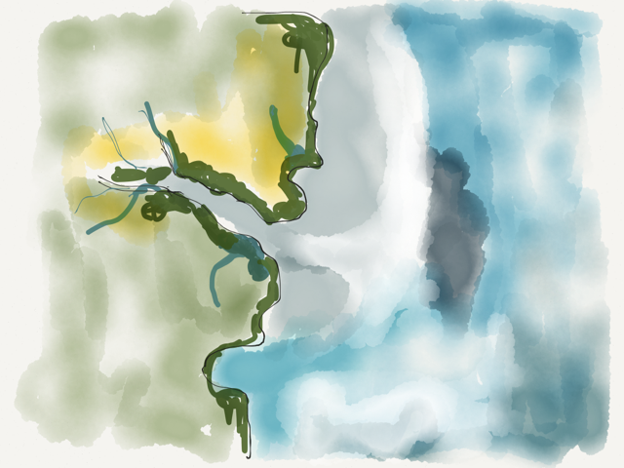
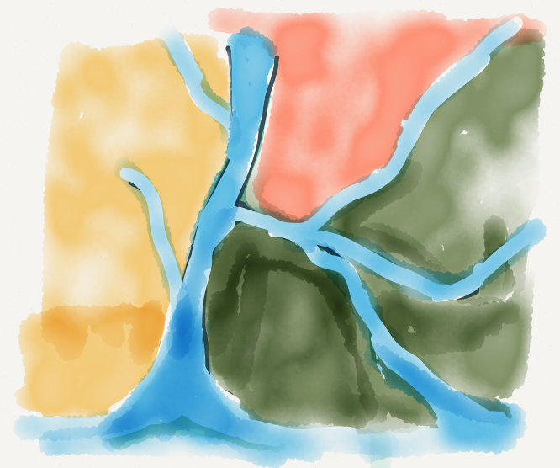
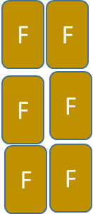
Figure 1: potential steps in the spatial planning and management process
zones
F
F
F
F
F
F
F
F
F
F
AMA 1
sites
F
F
F
F
F
F
AMA 2
F
F
F
F
F
F
F
AMA 3
F
AMA
F
F
F
F
F
F
F
F
F
F
F
F
F
F
F
F
AMA 4
Marine aquaculture
F
F
F
F
F
F
F
F
F
F
AMA 2
F
F
AMA 1
F
F
F
F
F
F
F
F
F
F
F
F
F
F
F
AMA 3
F
F
F
AMA 4
F
F
F
F
Inland aquaculture

Slide 4
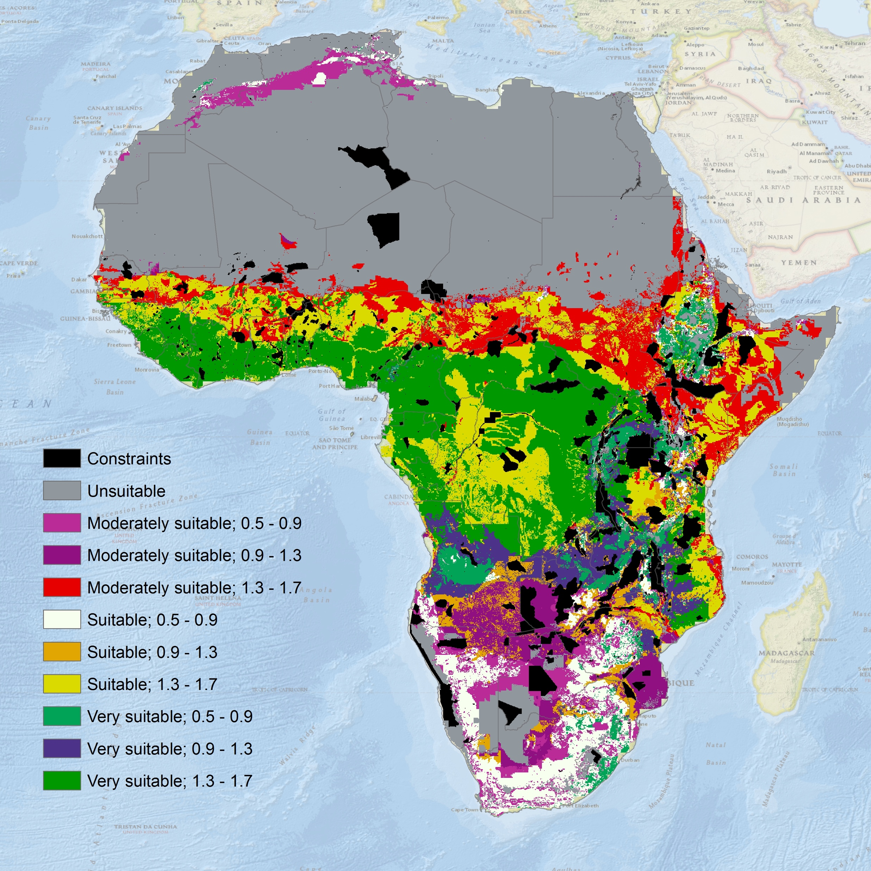
Figure 2: suitability for Tilapia

Slide 5
Figure 3: Output from a fish farm particulate waste deposition model

Slide 6
Figure 4: Fish production in overcrowded (pre-2009) and optimal densities

Slide 7
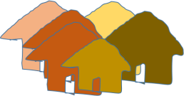
Figure 5a: aqua-cultural sites within AMA within zones
F
F
F
F
AMA 1
F
AMA 2
F
F
F
F
F
AMA 3
F
F
F
F
F
F
F
F
AMA 4
F
F
Marine aquaculture

Slide 8
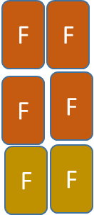
Figure 5b: aquacultural sites within AMA
F
F
F
F
F
AMA 2
F
AMA 1
F
F
F
F
F
F
AMA 3
F
F
F
AMA 4
F
F
Inland aquaculture

Slide 9
Figure 6: MODIS remote sensing of southern Chile (first part)

Slide 10
Figure 6, second part
Source: Stockwell et al., 2006

Slide 11
For more information about
the AquaSpace Masters module
and spatial planning toolbox,
visit our website:
www.aquaspace-h2020.eu
The materials used here have been assembled as part of the AquaSpace project (Ecosystem Approach to making Space for Aquaculture, http://aquaspace-h2020.eu) and has received funding from the European Union's Horizon 2020 Framework Programme for Research and Innovation under grant agreement n° 633476.
Horizon 2020

