Slide 1
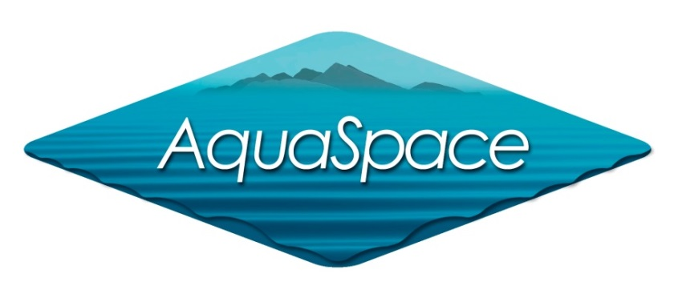
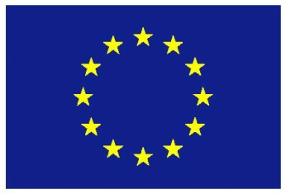
Topic 1: Aquaculture in a Global Context
CPD Course
PLANNING AND MANAGING THE USE OF SPACE FOR AQUACULTURE
Joao G. Ferreira
New University of Lisbon
The materials used here have been assembled as part of the AquaSpace project
(Ecosystem Approach to making Space for Aquaculture, http://aquaspace-h2020.eu)
and has received funding from the European Union's Horizon 2020 Framework Programme
for Research and Innovation under grant agreement n° 633476.
They may be used under a Creative Commons Attribution-ShareAlike 4.0 International License, with attribution to the author
Horizon 2020

Slide 2

Aquaculture in a Global Context
Overview
Global patterns in fisheries and aquaculture production
Worldwide consumption and future trends
The European situation in perspective
Species and technologies
Carrying capacity and sustainability challenges
Synthesis

Slide 3
Aquaculture in a Global Context
1 - Global patterns in fisheries and aquaculture production
Overview of world production
Decadal trends in fisheries and aquaculture
Production of main wild-caught fish species
Capture fisheries by country
Relevance of world aquaculture
Development of world aquaculture

Slide 4
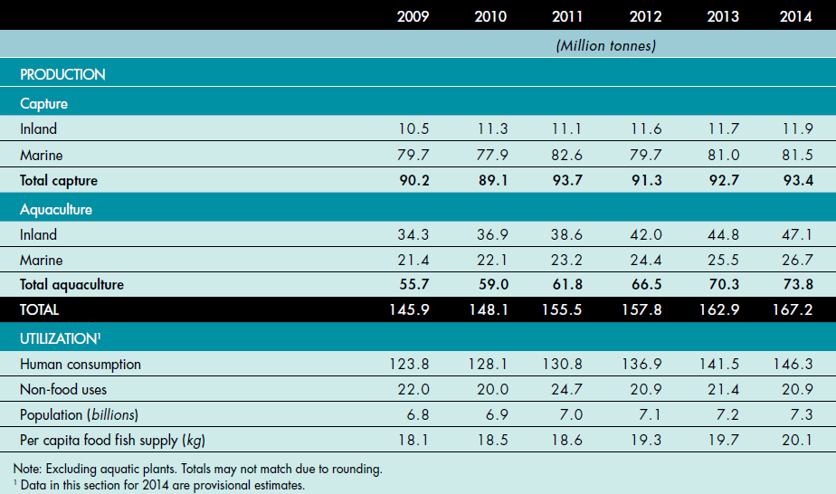
World capture fisheries and aquaculture (2016)

Slide 5
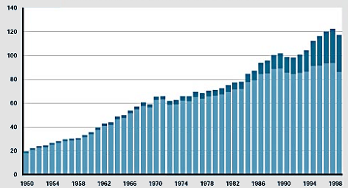
The state of world fisheries and aquaculture
SOFIA 2000 (FAO)
10⁶ ton y⁻¹
Aquaculture
Fisheries
FAO, 2001. The State of World Fisheries and Aquaculture (SOFIA). Food and Agriculture Organization of the U.N.

Slide 6
The state of world fisheries and aquaculture
SOFIA 2014 (FAO)
FAO, 2014. The State of World Fisheries and Aquaculture (SOFIA). Food and Agriculture Organization of the U.N.
Fisheries are declining, growth in aquatic products is driven by aquaculture.

Slide 7
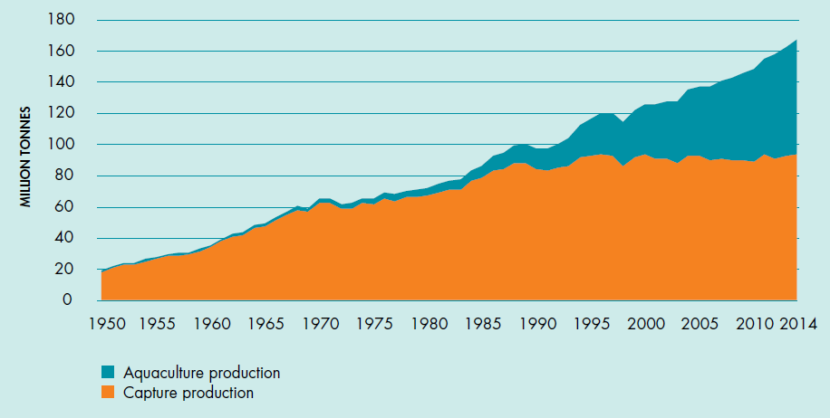
The state of world fisheries and aquaculture
SOFIA 2016 (FAO)
FAO, 2016. The State of World Fisheries and Aquaculture (SOFIA). Food and Agriculture Organization of the U.N.
Aquaculture continues to grow at an APR of 6% per year.
Notes:
k value from dB/dt = kB is 0.06 for a 14 year period, starting at 33MT in 2000 and ending at 77MT in 2014

Slide 8


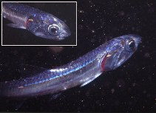



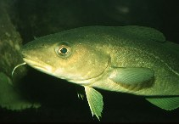

Distribution of production among major fish species
Alaska pollock
4
4.5
Atlantic herring
2.4
2.3
Japanese anchovy
2.1
1.3
Chilean jack mackerel
2
4.4
Chub mackerel
1.9
2.2
Skipjack tuna
1.9
1.6
Anchoveta
1.7
8.9
Largehead hairtail
1.4
1.3
Atlantic cod
1.2
1998
1.3
Blue whiting
1.2
1996
0.6
Yellowfin tuna
1.2
1.1
0
2
4
6
8
10
Production (10⁶ ton y⁻¹)
FAO, 2001. The State of World Fisheries and Aquaculture (SOFIA). Food and Agriculture Organization of the U.N.

Slide 9
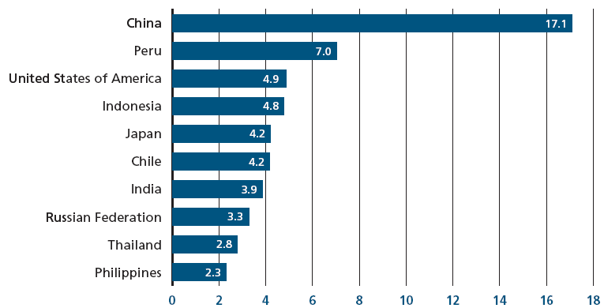
Capture fishery production by country
SOFIA 2008 (FAO)
Capture fishery production (10⁶ ton y⁻¹)
FAO, 2008. The State of World Fisheries and Aquaculture (SOFIA). Food and Agriculture Organization of the U.N.

Slide 10
Relevance of world aquaculture
Volume and value
FAO Global Aquaculture Conference 2010
50% of aquatic products originate from aquaculture (SOFIA, 2010)
90% of the 68 million tonnes of aquaculture products (105 billion USD) originate from Asia (Sorgeloos, 2010)
Production of striped catfish Pangasius in the Mekong delta is >1 Mt y⁻¹, highest yields in the world, 350-400 tonnes ha⁻¹ per crop (Sena da Silva, 2010)
30 Mt y⁻¹ of extra aquatic products required to feed the planet by 2050 (Swaminathan, 2010)
US predicted expansion from 0.5 to 1.5 Mt y⁻¹ (Olin, 2010)
Europe: production is 4.2% by volume, 9.1% by value (Sorgeloos, 2010)
Growth of both population and aquaculture will take place in developing nations
Notes:
Much of the world’s aquaculture takes place in ponds. Even saltwater aquaculture. Thailand – smallholdings. Average FW pond: 0.28 ha; average coastal pond: 0.8 ha;

Slide 11
Trends in fisheries and aquaculture – SOFIA 2016
85
80
75
Capture fisheries for human consumption
y = -0.431x² + 174.11x - 175815
70
r² = 0.9455
Live weight (10⁶ tonnes per year)
65
May 2013
60
y = -0.0875x² – 348.5x - 346925
55
r² = 0.9992
Aquaculture
50
Data points
Extrapolation
45
40
2004
2006
2008
2010
2012
2014
2016
Year
Equivalent to the emergence of agriculture 10,000 years ago in the Neolithic period.

Slide 12
60
50
40
% fisheries
30
Live weight (10⁶ tonnes per year)
20
10
0
For projected APR growth in aquaculture and fisheries, 155 million tonnes in Sept 2016.
Notes:
APR – Annual Percentage Rate

Slide 13
Aquaculture in a Global Context
2 - Worldwide consumption and future trends
Patterns of fish consumption
The challenge of aquatic food security

Slide 14
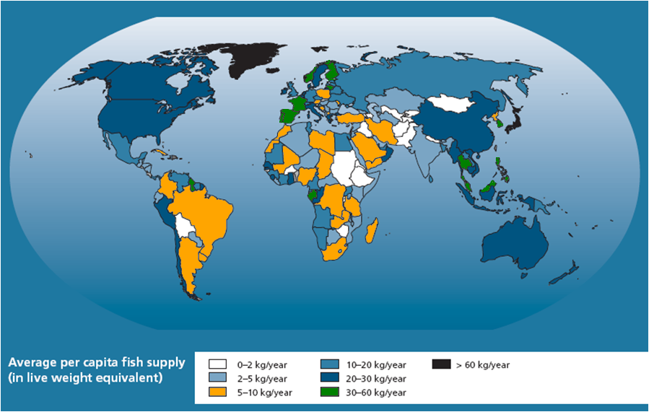
Fish as a food
World per capita supply (average 2003-2005)
FAO, 2009. The State of World Fisheries and Aquaculture (SOFIA). Food and Agriculture Organization of the U.N.

Slide 15
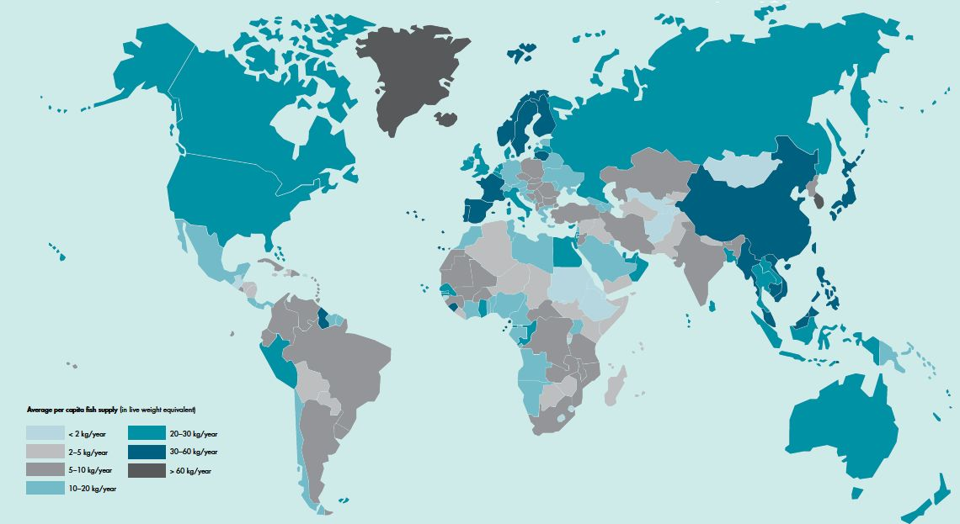
Fish as a food
World per capita supply (average 2011-2013)
FAO, 2016. The State of World Fisheries and Aquaculture (SOFIA). Food and Agriculture Organization of the U.N.

Slide 16
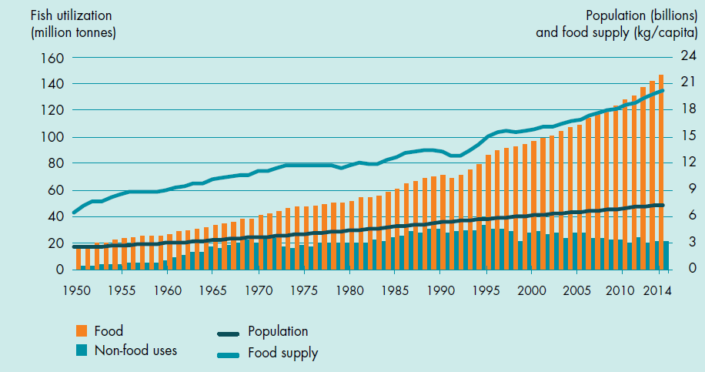
The state of world fisheries and aquaculture
SOFIA 2016 (FAO)
FAO, 2016. The State of World Fisheries and Aquaculture (SOFIA). Food and Agriculture Organization of the U.N.
Balance of supply and demand. Non-food uses are decreasing.
Notes:
note different scales

Slide 17
Aquaculture in a Global Context
3 - The European situation in perspective
European production framework
Import of aquatic products to Europe and the US
Breakdown of production by country
Legal frameworks

Slide 18
Aquaculture in the European Union
Sustainability and legislation
Environmental, legal, and social pressures
Aquaculture is the most heavily regulated food production sector in Europe (Varadi, 2010)
Competition for space, access to capital, availability of special services, limited authorised veterinary products (Varadi, 2010)
Water Framework Directive (2000/60/EC) – no reference to aquaculture. Benthic biodiversity, fish (in transitional waters); Good Ecological Status in Europe by 2015
Marine Strategy Framework Directive (2008/56/EC) – Fish and Shellfish Quality Descriptor (QD3). Aquaculture is seen only as a pressure. Good Environmental Status by 2020
Many other parts of the world don’t come close to the EU regulatory panorama
The EU faces a huge aquatic food security challenge in the next years.

Slide 19
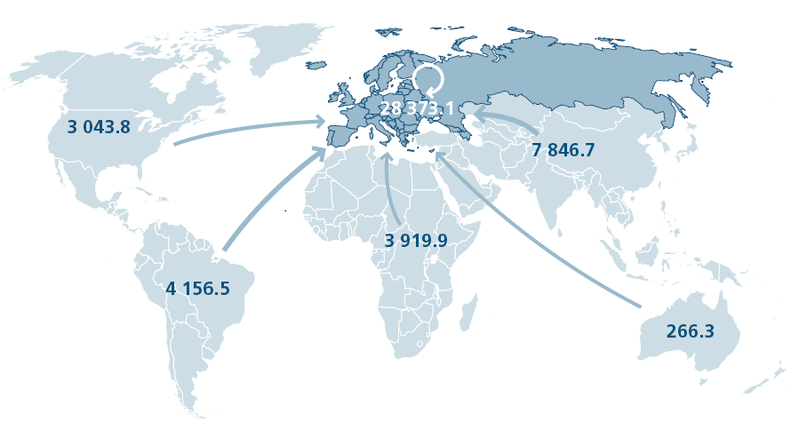
Imports to Europe
All numbers in millions of USD (SOFIA 2012)
Europe imports 74% of its aquatic products. The USA imports 86%
If European consumption was at the level of Portugal (57.4 kg y⁻¹ per capita) an extra 27 million tonnes of fish products would be required annually.
Notes:
Total 709,979,368 14,178,392 40,752,816 26,574,424 Dietary shift. Updated import data: Fig. 24, SOFIA 2012. USA 86% from Tiller et al., 2013.

Slide 20
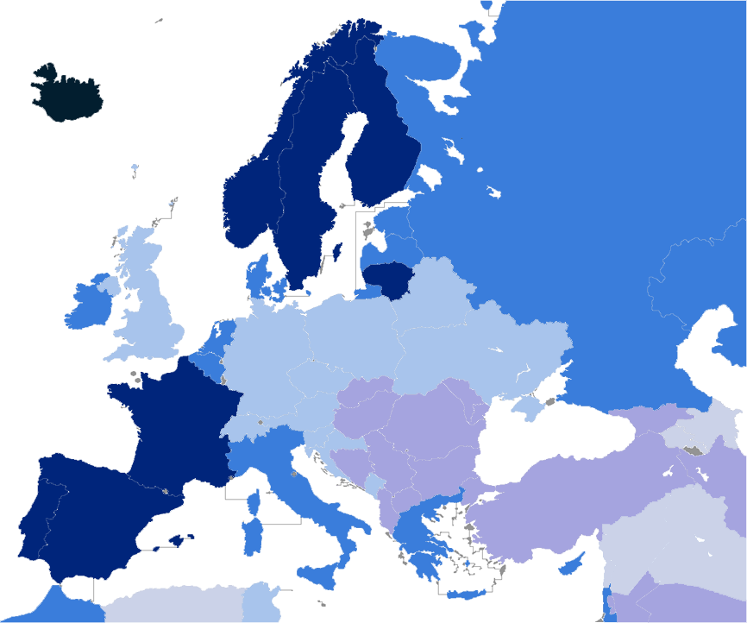
Iceland 7 kt
Artic char, salmon
Per capita consumption of aquatic products (2010)
> 60 kg y⁻¹
30-60 kg y⁻¹
UK 203 kt
Salmon, mussels, trout
20-30 kg y⁻¹
Norway 1321 kt
Salmon, trout
10-20 kg y⁻¹
5-10 kg y⁻¹
2-5 kg y⁻¹
Ireland 36 kt
Mussels, salmon
Denmark 39 kt
Trout, eel
Poland 32 kt
Carp, trout
Netherlands 46 kt
Mussels, oysters
France 167 kt
Oysters, mussels
Production by nation
Hungary 15 kt
Carp, catfish
Turkey 213 kt
Trout, bream, bass
Greece 138 kt
Bream, bass, mussels
Israel 20 kt
Tilapia, carp, mullet
Portugal 10 kt
Turbot, clams, bream
Spain 264 kt
Mussels, trout, bream
Italy 163 kt
Mussels, trout, clams
Notes:
Denmark: trout is major production, site below refers 700 t mussels
http://www.eurofish.dk/index.php?option=com_content&view=article&id=113%3Adenmark&catid=37&Itemid=34
World salmon production – Marine Harvest 2014: worldwide: 100 million smolt – 100 million fish @ 5 kg = 0.5 million tonnes. MH produces 1 in 4 so world production ~ 2 million tonnes. One company produces 40% of all the EU.

Slide 21
Legal frameworks for aquaculture
Asia 90%. Rest of the world: 10% of production
Country | Basic Legislation | Authorisation System | Environmental Impact Assessment (EIA)
EU | Horizontal directives, MSFD, WFD, shellfish directives | Licensing, water quality permitting | Required
USA | Federal and state level | Registration with state authorities. May vary among states | Usually required, may vary among states
Canada | Oversight by federal, provincial and local authorities. | Federal and provincial governments issue licences | Required
Norway | - Aquaculture Act (2005). - EEA agreement | Licence. Regulators may limit number of licences | Required for large aquaculture installations
Chile | - Fisheries and Aquaculture Law | Permit | Required for large aquaculture installations
New Zealand | - Resources Management Act (RMA) | Resource consent | Required
Asymmetry in regulatory instruments and requirements for environmental compliance on a global scale.

Slide 22
Aquaculture in a Global Context
4 - Species and technologies
What is grown and how
Examples from four continents
Species combinations (integrated culture)

Slide 23
Types, species, and structures
Aquaculture type | Group | Example species | Cages | Ponds | Bottom | Lines/rafts | RAS*
Fed aquaculture | Finfish | Atlantic salmon | X |  |  |  | X
 |  | Rainbow trout | X |  |  |  | X
 |  | Tilapia |  | X |  |  | X
 |  | Carp |  | X
 |  | Seabass | X |  |  |  | X
 |  | Gilthead | X |  |  |  | X
 | Shrimp | White shrimp, tiger shrimp |  | X |  |  | X
Organic extractors | Filter-feeders | Oysters, mussels, scallops |  |  | X | X
 |  | Clams |  |  | X
 | Deposit feeders | Sea cucumber, abalone |  |  | X
Inorganic extractors | Seaweeds | Porphyra (nori) |  |  |  | X
 |  | Saccharina, Alaria, Undaria |  |  |  | X
*RAS: Recirculating Aquaculture System
FAO provides a complete database of species and production volumes worldwide.

Slide 24
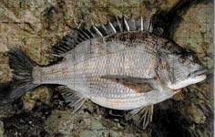
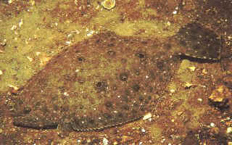
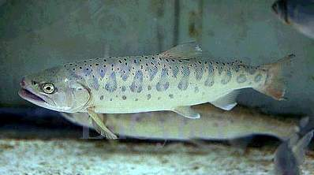
Black sea bream, Acanthopagrus
schlegeli
Black rockfish, Sebastes schlegeli
Olive flounder, Paralichthys olivaceus
Mountain trout, Oncorhynchus masou

Slide 25
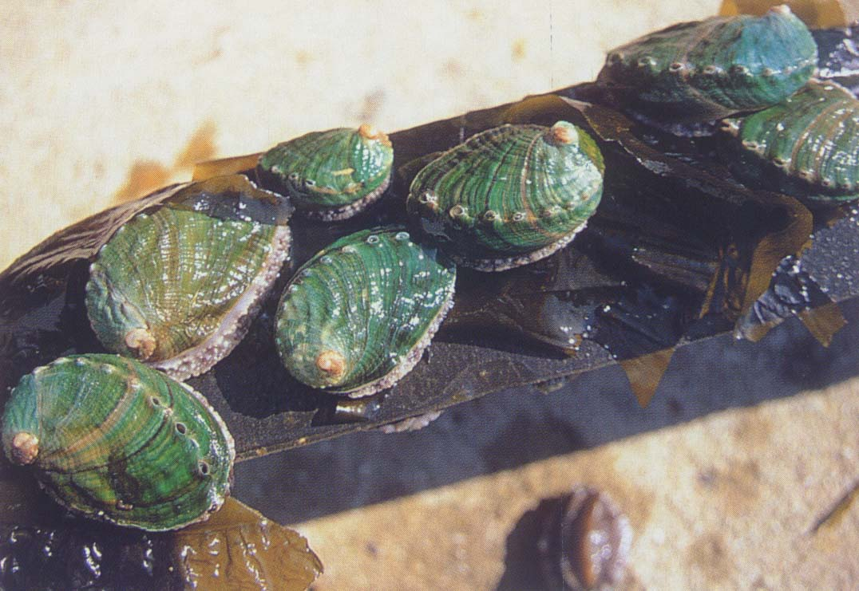
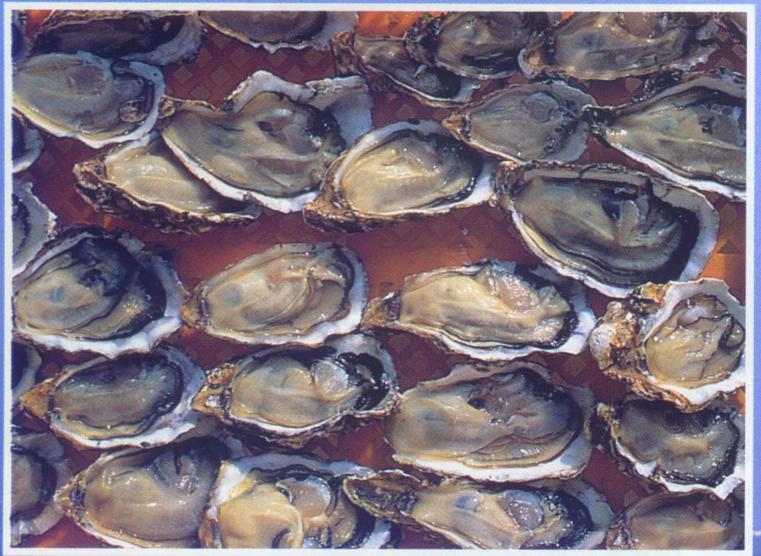
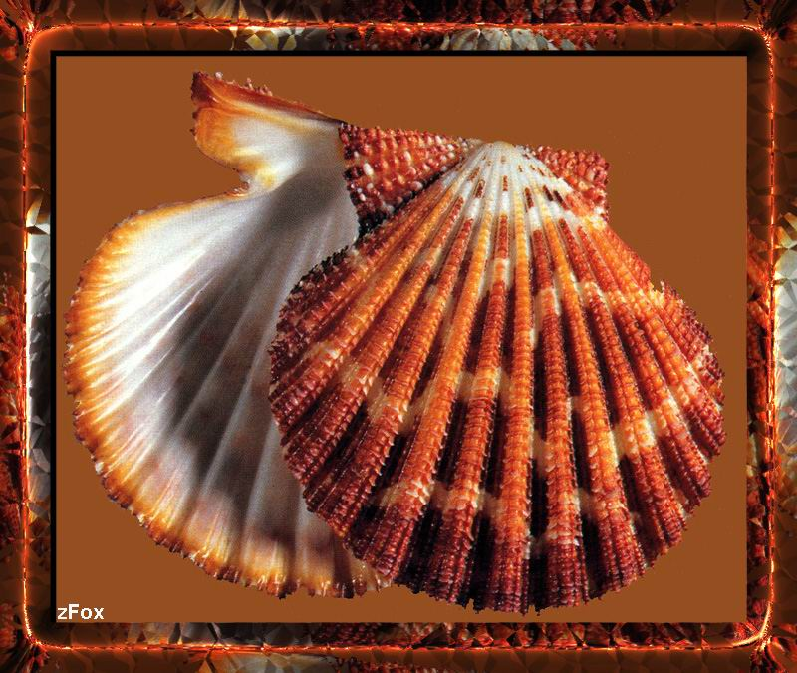
Abalone, Haliotis discus hannai
Pacific oyster, Crassostrea gigas
Chinese scallop,

Slide 26
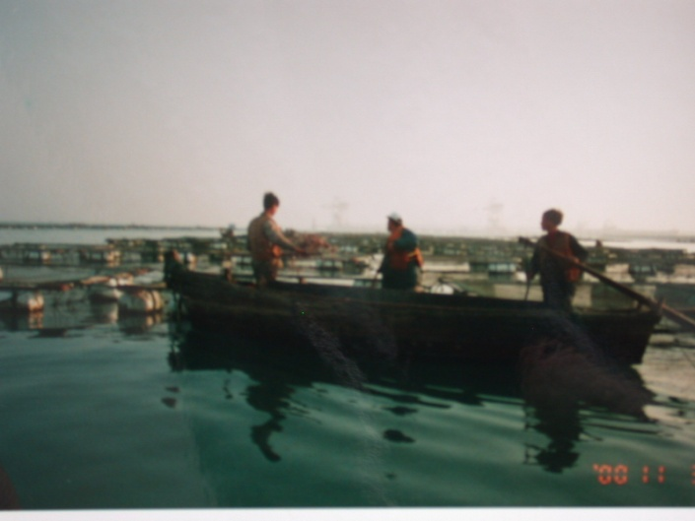
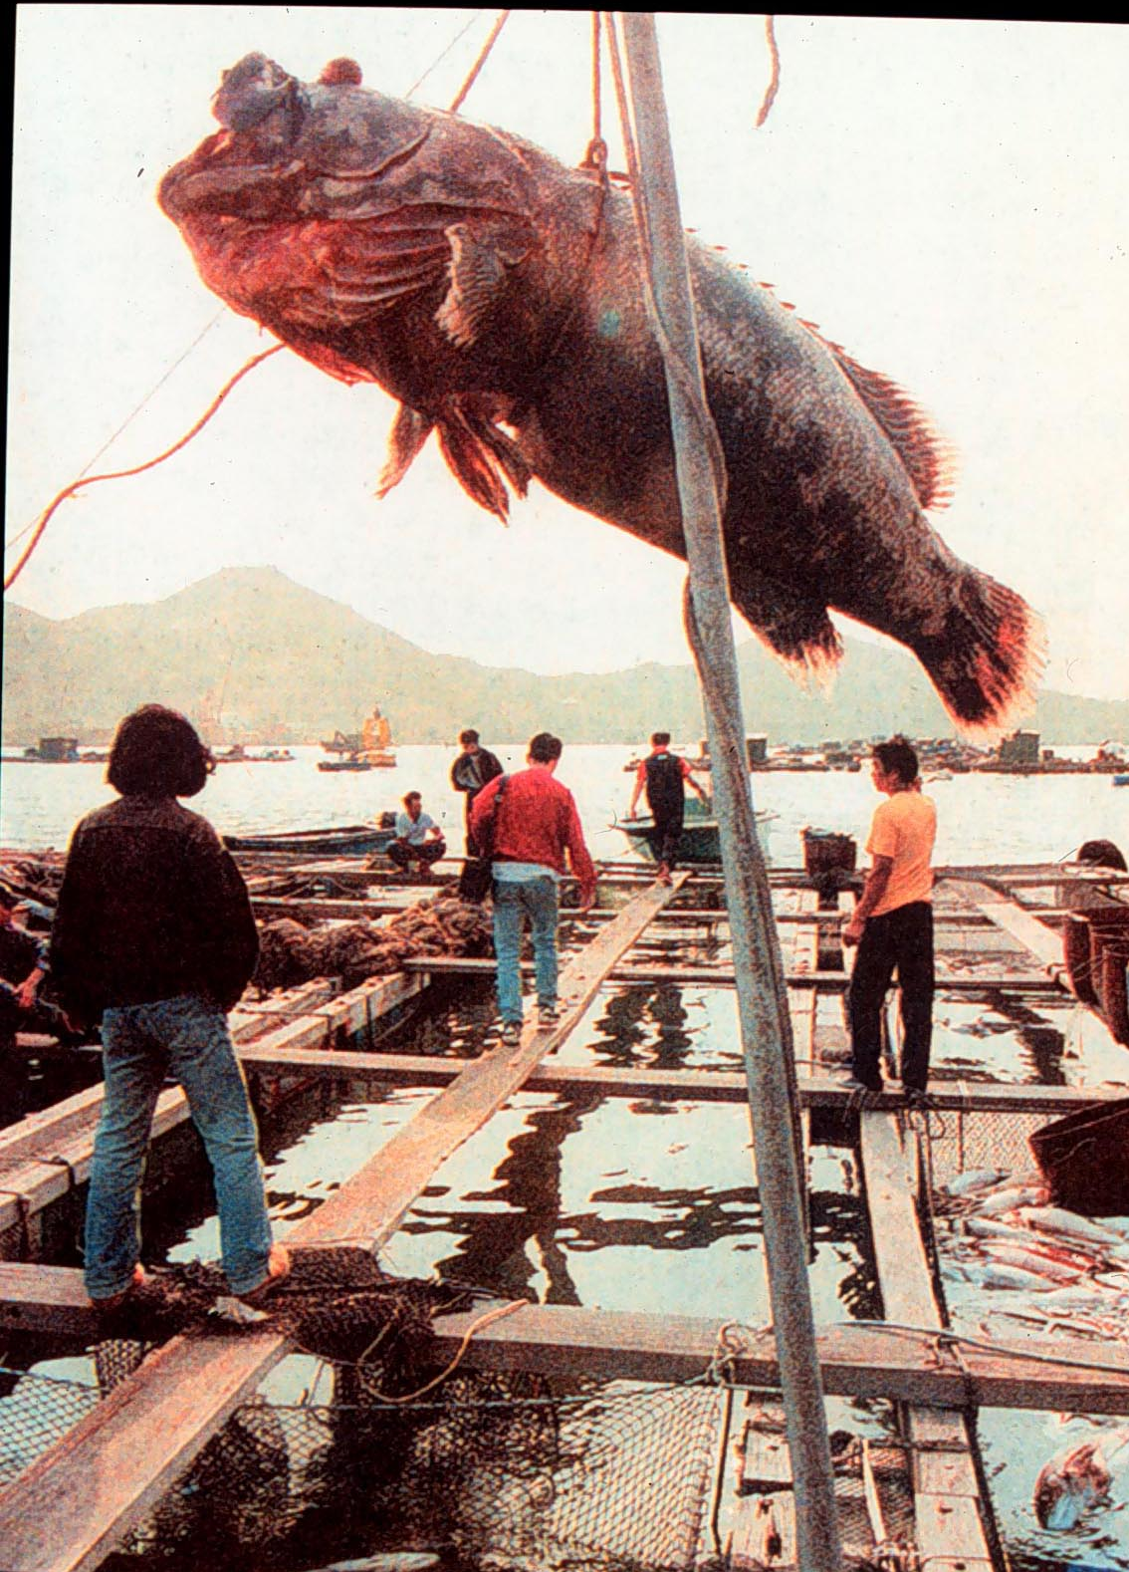
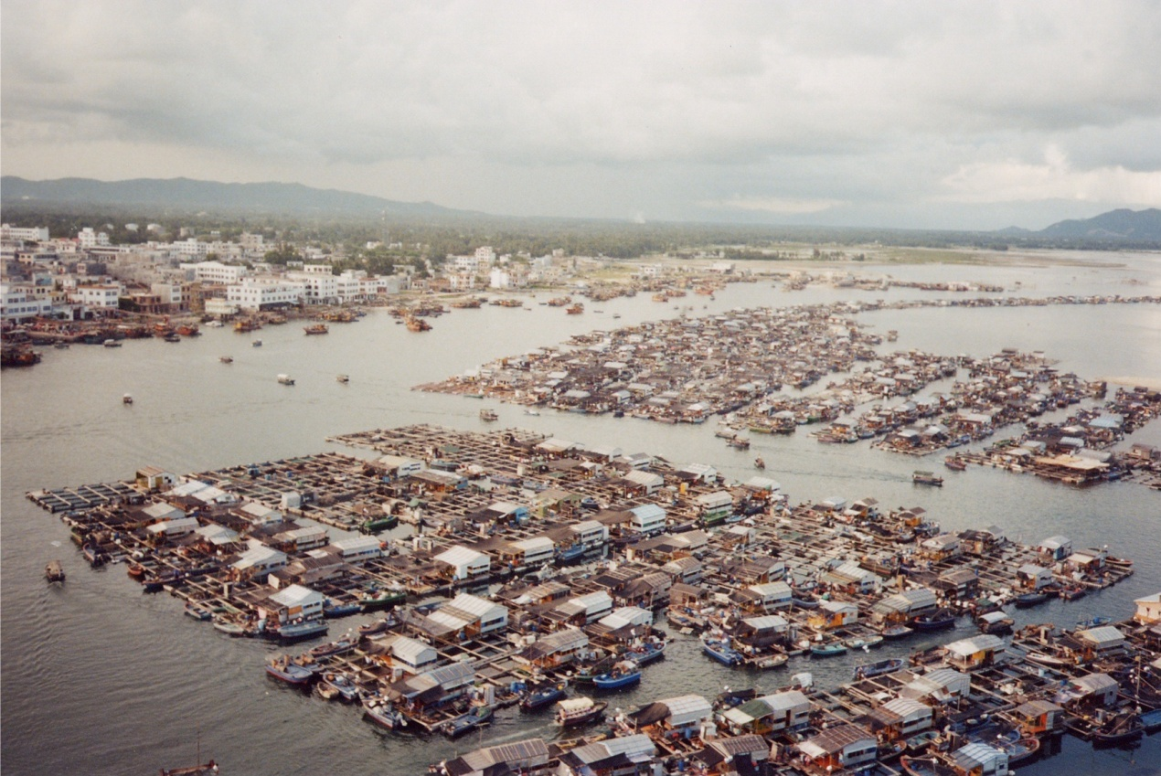
养殖生态类型
网箱养殖Cage Culture： 美国红鱼、
真鲷、

Slide 27
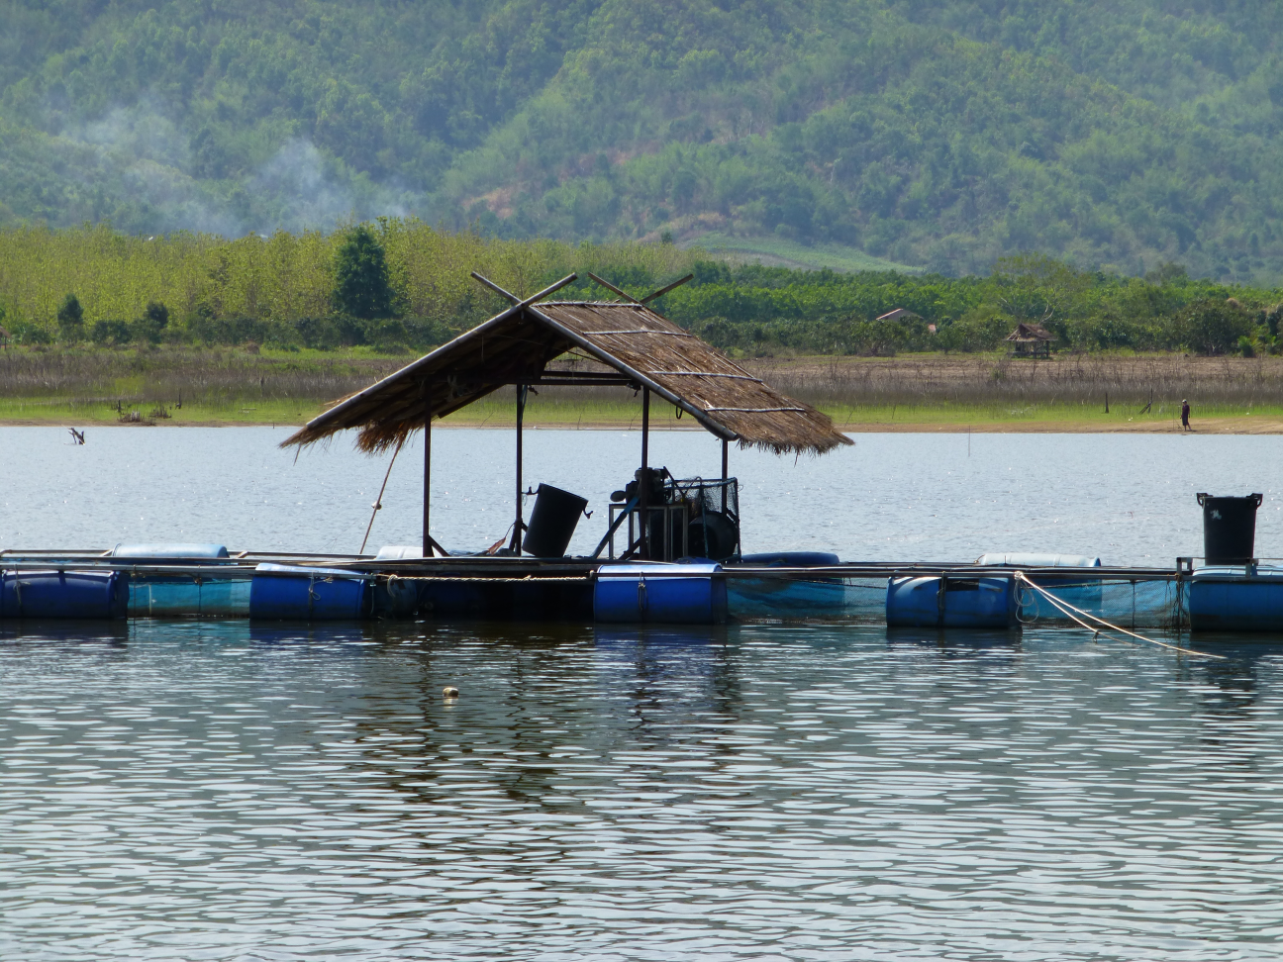
Aquaculture in Thailand - Mae Tak reservoir, Chiangrai
Tilapia, Oreochromis niloticus

Slide 28
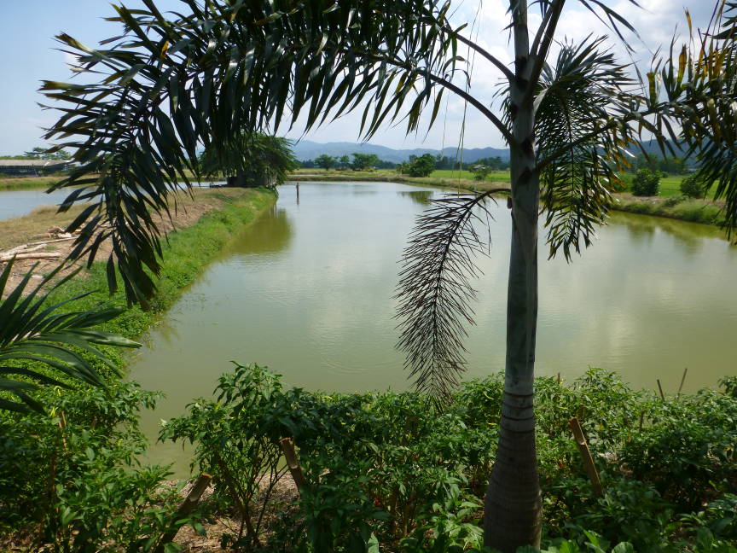
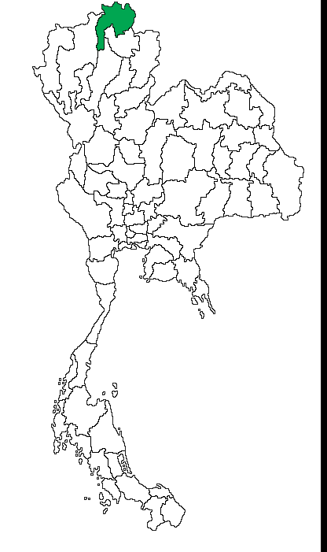
Chiangrai pond culture, Thailand
Tilapia, Oreochromis niloticus

Slide 29
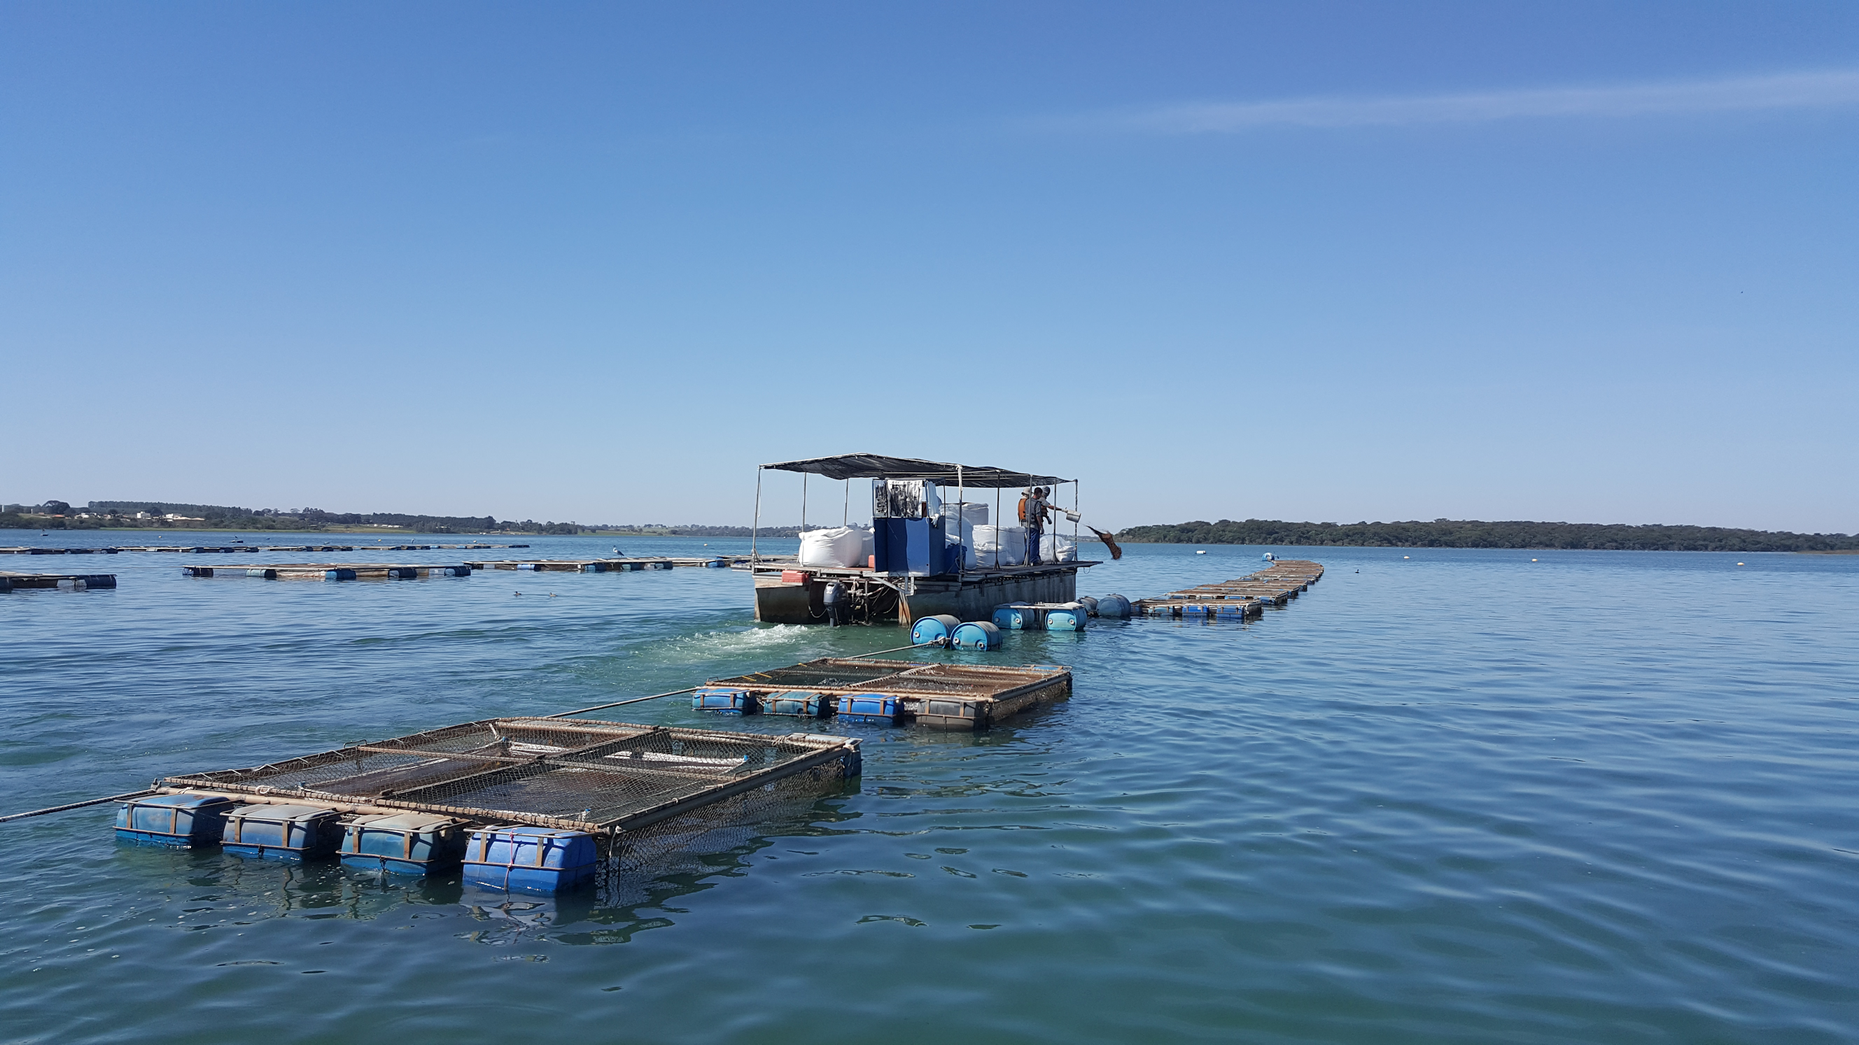
Aquaculture in Brazil – Santa Fé do Sul, São Paulo
Tilapia, Oreochromis niloticus
Notes:
Geneseas - one of two largest producers in Brazil

Slide 30
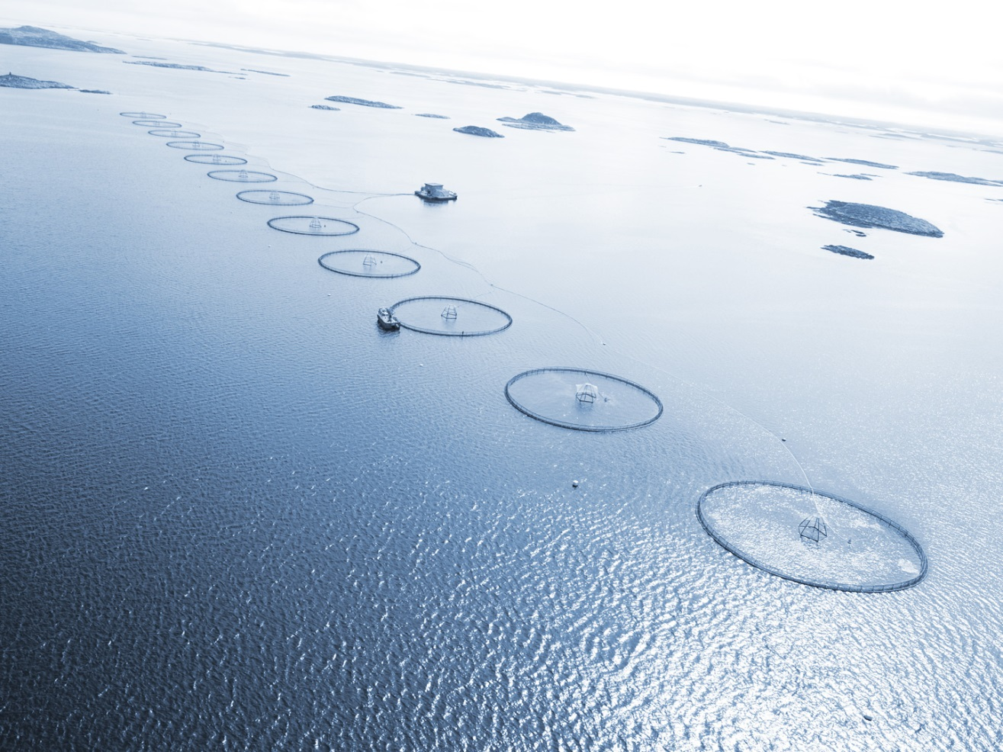
World’s largest offshore fish farming site (Atlantic salmon)
2010:
12,000 ton/year production
4 man-year
semi-exposed to the ocean
Cages supplied by Aqualine AS

Slide 31
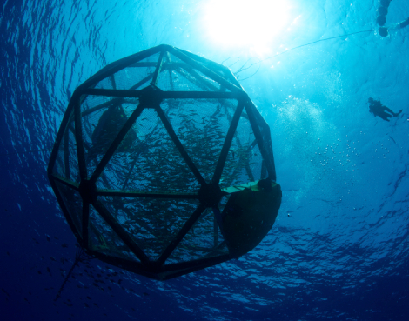
Offshore aquaculture – aquapods (shrimp)

Slide 32
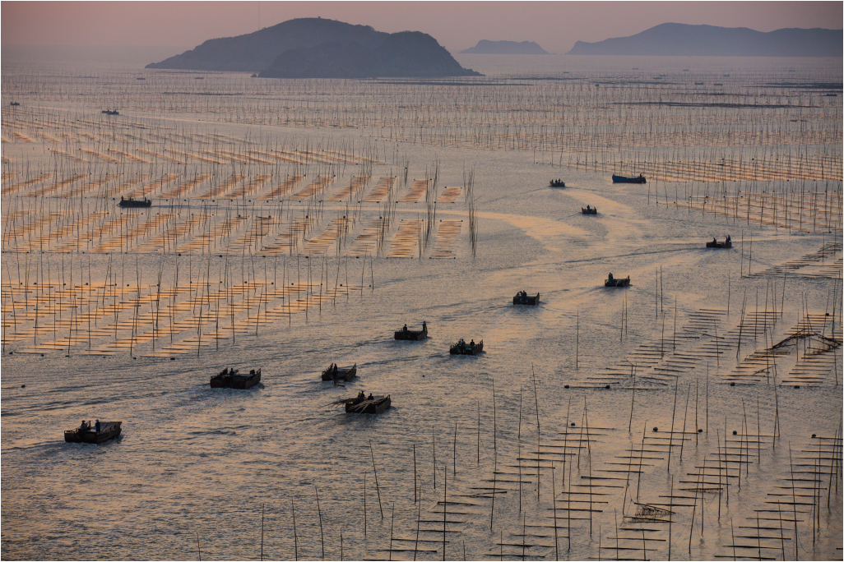
Nori in Fujian, China - Porphyra yezoensis
Worldwide production of 600,000 tonnes, feeds demand for Sushi.

Slide 33
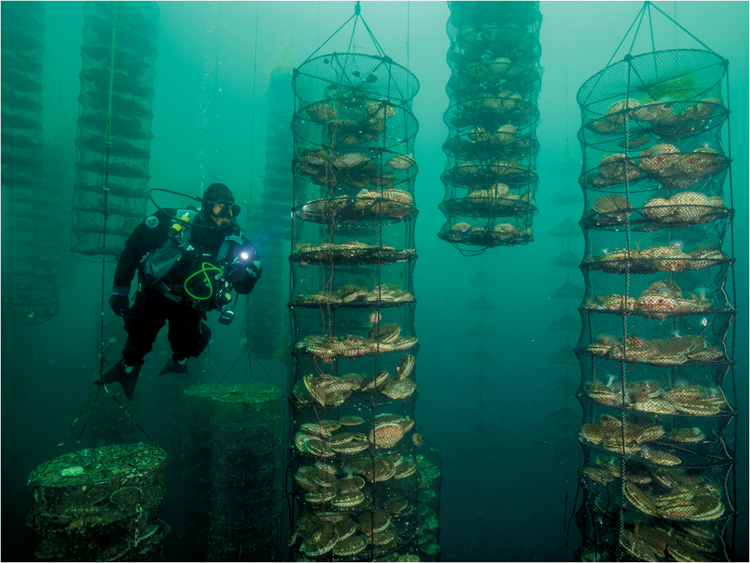
Integrated Multi-Trophic Aquaculture
Vancouver Island, Canada
Scallop lanterns as part of an IMTA setup that includes sablefish, kelp, and sea cucumbers.

Slide 34
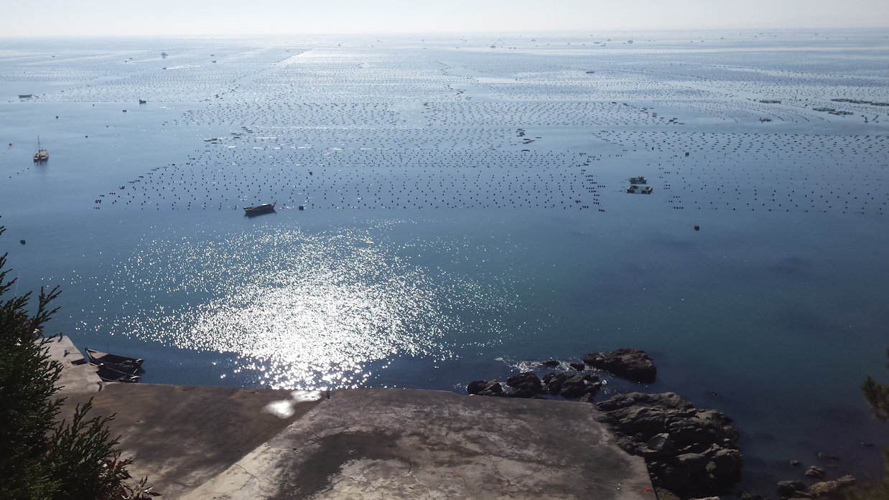
Sanggou Bay – December 2016
Aquaculture on a different scale
Seaweed, abalone, sea cucumber, oysters, scallops...

Slide 35
Aquaculture in a Global Context
5 - Carrying capacity and sustainability challenges
Tipping points and real-life examples
What is carrying capacity?
Different world visions of carrying capacity
The FAO Ecosystem Approach to Aquaculture

Slide 36
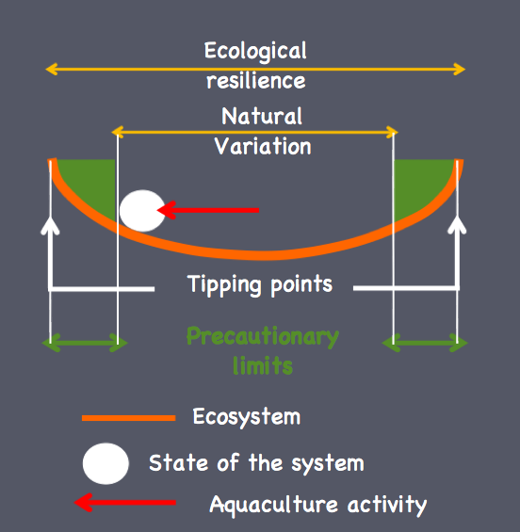
Sustainability criteria: foundation in classical ecology
Filgueira et al., 2013. Aquaculture Environment Interactions 4, 117-133.

Slide 37
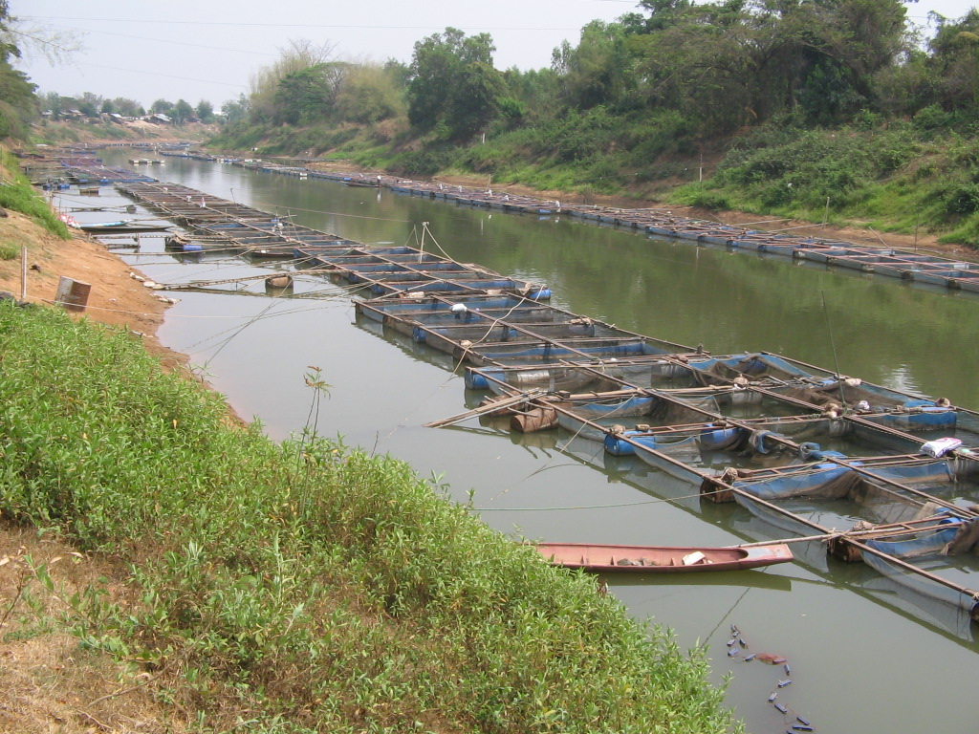
Nile tilapia
Central Thailand
Notes:
Tilapia cage culture along the river

Slide 38
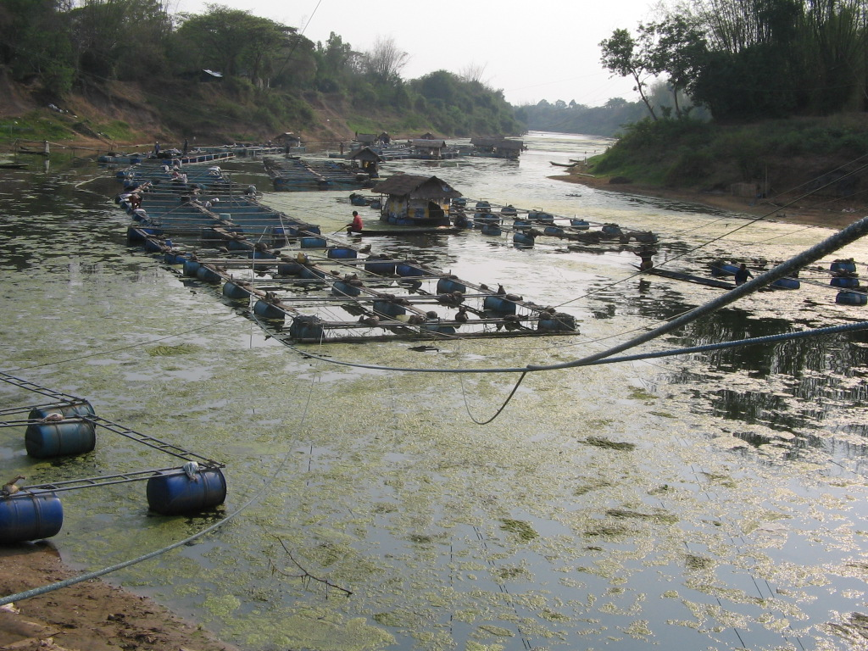
Nile tilapia
Central Thailand
Notes:
Eutrophication, hypoxia or anoxia, fish mortality

Slide 39
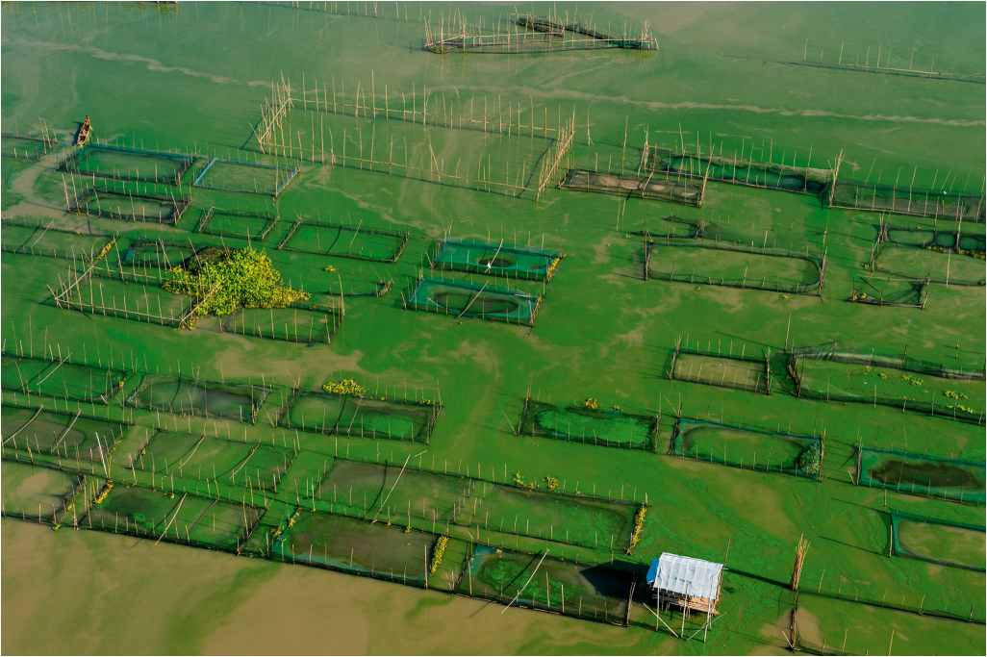
Tilapia cage culture
Laguna de Bay, Philippines
Overstocking and slow water turnover can lead to excess organic material.

Slide 40
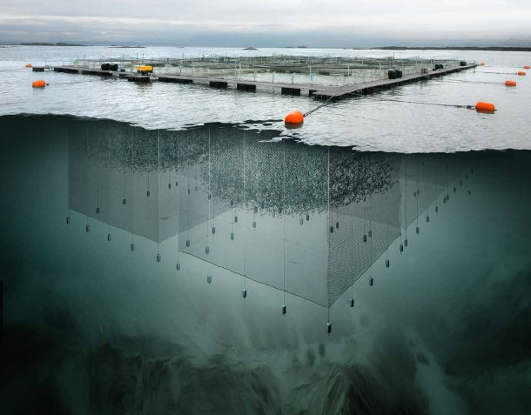
Carrying Capacity – a Multidimensional Problem
Governance
Social
Production
Ecology
Four pillars for sustainable aquaculture. In the West, the social pillar is limiting.

Slide 41
Different types of carrying capacity for aquaculture
Different parts of the world see carrying capacity in very different ways.

Slide 42
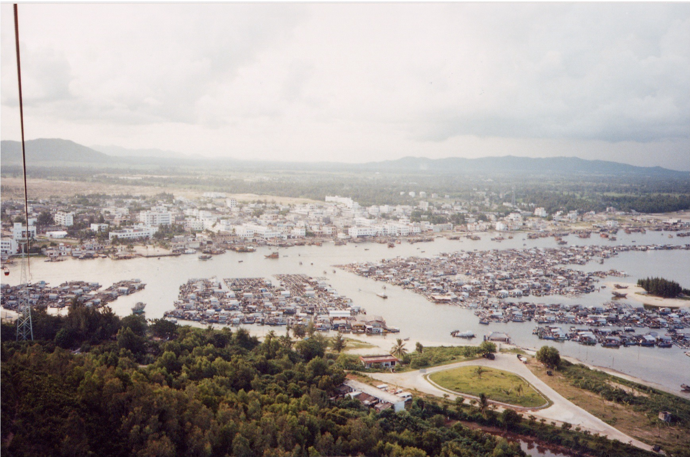
In China, social licence for aquaculture is very different from Europe

Slide 43
Ecosystem Approach to Aquaculture - FAO
Three principles
Aquaculture should be developed in the context of ecosystem functions and services (including biodiversity) with no degradation of these beyond their resilience;
Aquaculture should improve human-well being and equity for all relevant stakeholders;
Aquaculture should be developed in the context of other sectors, policies and goals.
Soto, 2010
EAA: ecosystem balance, social equity, multiple uses

Slide 44
Aquaculture in a Global Context
6 - Synthesis
Production models for the future
Planning approaches for data-poor nations
A blueprint for participative development
Synthesis

Slide 45
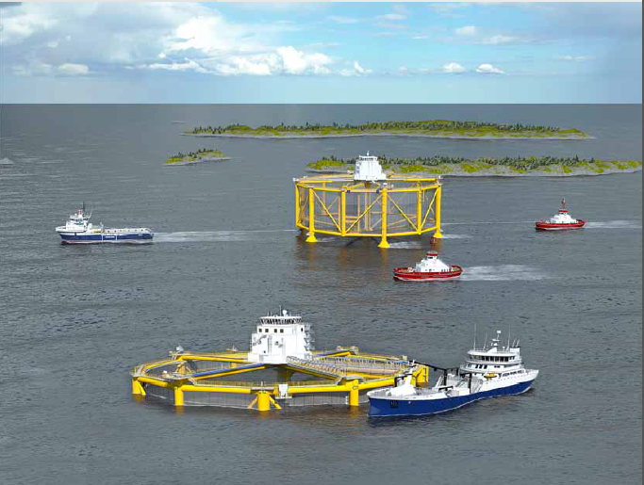
Offshore production platform idea 2015 – launched in 2017-2018

Slide 46
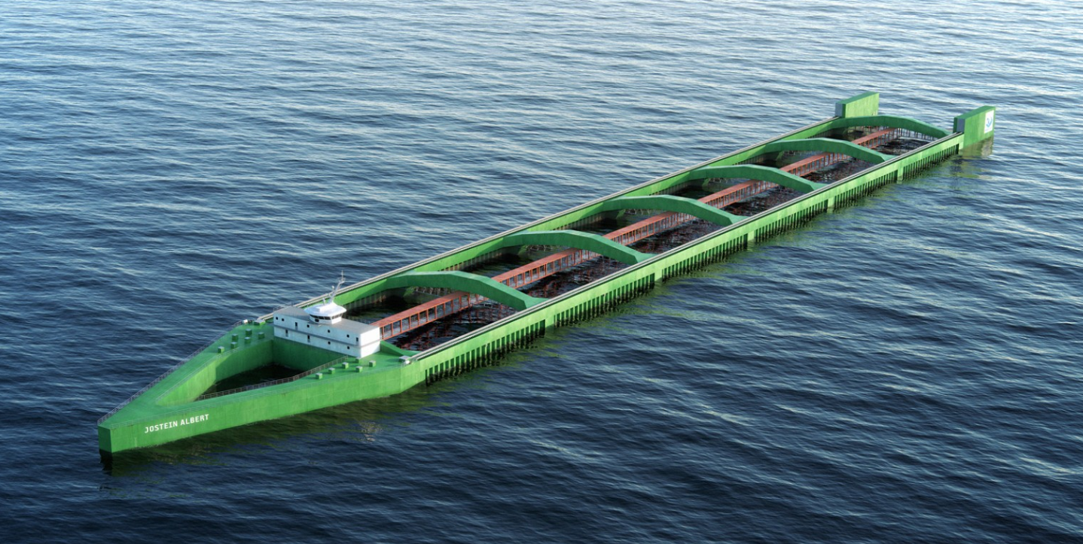
Nordlaks : An Ocean ship/cage solution to be tested

Slide 47
Systems approach for site selection
Legal constraints
Geographic area selection
Generation of constraint maps
Base map generation
Suitable
areas
No
No suitability
Use conflicts
Yes
STAGE 1
Physical suitability
Data sources
Multi-layer factor generation
Growth and survival
Water quality criteria
Sediment quality criteria
Factor suitability ranges
Factor suitability
Product quality
Ecological quality criteria
Multi-criteria evaluation
Environmental
sustainability
No suitability
No
Suitable
areas
Yes
STAGE 2
No business viability
Site selection
No
Detailed analysis of production, socio-economics, and environmental effects
Yes
Production feasibility
Farm-scale carrying capacity model
Environmental driver data or system-scale model outputs
Silva et al., 2011.
STAGE 3

Slide 48
The four orders of coastal governance outcomes
National
Scale
Regional
Local
Intermediate
outcomes
Final
outcomes
First order:
Enabling conditions
Formalized mandate with implementing authority
Management plans adopted
Funding secured
Constituencies present at local and national levels
Second order:
Changes in behaviour
Changes in
behaviour of
institutions and
stakeholder groups
Changes in
behaviours directly
affecting resources
of concern
Investments in
infrastructure
Third order:
The harvest
Some social and/or
environmental
qualities
maintained, restored,
or improved
Fourth order:
Sustainable coastal development
A desirable and dynamic balance between social and environmental conditions is achieved
Time
Avoiding the ‘paper park’ syndrome

Slide 49
Summary
Fisheries are an important and traditional human activity;
Aquaculture has replaced fisheries as the main source of aquatic protein, but fishing (like hunting) will not disappear;
Aquaculture, like agriculture, needs to be sustainable. Probably only a few species will be cultivated at scale;
Different technologies are used worldwide for cultivating aquatic organisms;
Carrying capacity and site selection are key for sustainable and harmonious growth of the economy of the sea;
The distinction should not be between wild and farmed fish, but between good and bad fish;
A good fish is nutritious and tasty, environmentally friendly, and raised with due consideration for animal welfare.

Slide 50

For more information about
the AquaSpace CPD Course
and spatial planning toolbox,
visit our website:
www.aquaspace-h2020.eu
The materials used here have been assembled as part of the AquaSpace project
(Ecosystem Approach to making Space for Aquaculture, http://aquaspace-h2020.eu)
and has received funding from the European Union's Horizon 2020 Framework Programme
for Research and Innovation under grant agreement n° 633476.
Horizon 2020

