Slide 1


Topic 2: Current Frameworks for Aquaculture Planning and Management
CPD Course
PLANNING AND MANAGING THE USE OF SPACE FOR AQUACULTURE
Anne Marie O’Hagan
MaREI, ERI, UCC
The materials used here have been assembled as part of the AquaSpace project
(Ecosystem Approach to making Space for Aquaculture, http://aquaspace-h2020.eu)
and has received funding from the European Union's Horizon 2020 Framework Programme
for Research and Innovation under grant agreement n° 633476.
They may be used under a Creative Commons Attribution-ShareAlike 4.0 International License, with attribution to the author
Horizon 2020

Slide 2
Overview
Legal basis for EU law on environment, fisheries and aquaculture
Key EU legal instruments for marine / coastal management
Conservation
Impact assessment processes

Slide 3
EU Legal basis
Article 3(3) TEU defines the objectives of the EU:
  “The Union shall work for sustainable development of Europe based on balanced economic growth and price stability (…) and a high level of protection and improvement of the quality of the environment”
Art. 191 TFEU: defines objectives and principles of EU environmental policy (+ new legal basis for climate change and Art. 194 sets a new legal basis for EU energy policy)
Transboundary effects in third countries: international treaties/agreements

Slide 4
Legal Principles
Article 5 TEU defines general principles/mechanisms of EU law:
  Proportionality
  Subsidiarity
Article 191(2) TFEU defines environmental principles: “Union policy on the environment shall aim at high level of protection taking into account the diversity of situations in the various regions of the Union. It shall be based on the precautionary principle and on the principles that preventive action should be taken, that environmental damage should as a priority be rectified at source and that the polluter should pay”
Notes:
Subsidiarity = the community shall only take action where if the objective cannot be sufficiently achieved by Member States, and can therefore be better achieved by the Community
Proportionality – any action taken by the Community shall not go beyond what is necessary to achieve the objectives of the EC Treaty

Slide 5
Areas of Competence
Exclusive Competence | Shared Competence | Competence to support, coordinate or supplement MS action | Competence to provide arrangements within which EU member states must coordinate policy
Conservation of marine biological resources under Common Fisheries Policy Concluding international agreements Non-exhaustive | Agriculture and fisheries, excluding the conservation of marine biological resources Economic, social and territorial cohesion Environment Energy Research, Tech. dev. | Human health Industry Culture Tourism Education & training Civil protection Administrative cooperation | Economic policy Social policies Employment
Notes:
Exclusive: customs, competition, monetary policy, concluding international agreements when their conclusion is required by a legislative act of the EU when their conclusion is necessary to enable the EU to exercise its internal competence in so far as their conclusion may affect common rules or alter their scope.

Slide 6
EU Directives
Over 200 relevant to the marine environment
Horizontal (Cross cutting) – Environmental Assessment; Environmental Justice and Information
Sectoral
  Bathing water quality (revisions), Shellfish water (revisions), Waste water treatment, Nitrates, Water Framework Directive
  Marine Strategy Framework Directive
  Birds Directive, Habitats Directives
  Floods Directive
  Maritime Spatial Planning Directive

Slide 7
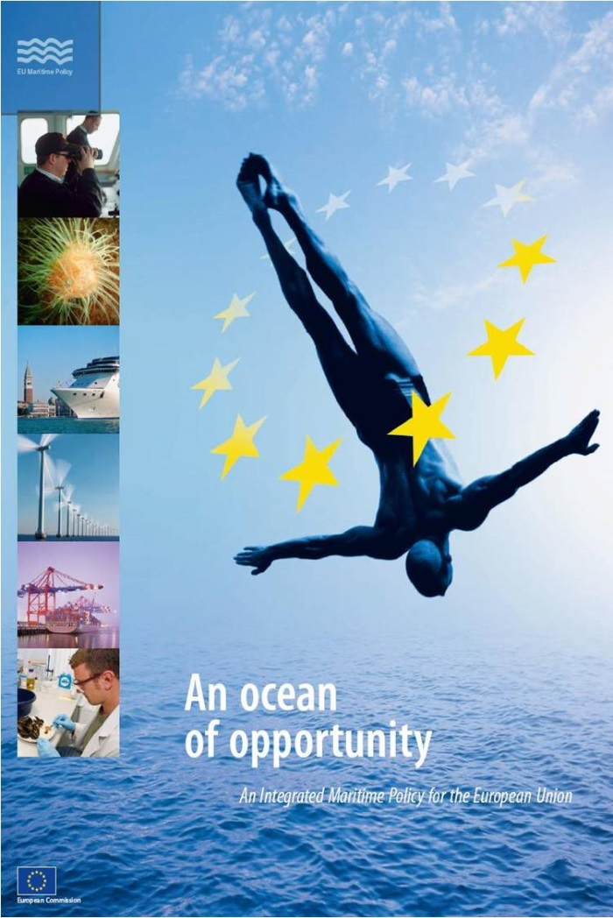
Integrated Maritime Policy
“All matters relating to Europe's oceans and seas are interlinked, and that sea-related policies must develop in a joined-up way if we are to reap the desired results”
Cross-cutting policies:
Sea-basin strategies
Blue Growth
Marine data and knowledge
Maritime Spatial Planning
Integrated maritime surveillance
Notes:
2007

Slide 8
Marine Strategy Framework Directive
(2008/56/EC) [1]
Establishes a framework within which Member States take measures to achieve or maintain Good Environmental Status in the marine environment by 2020
First attempt at an Ecosystems-based Approach
Applies to ‘marine waters’ from baseline to 200M
First EU legal instrument with an objective to maintain marine biodiversity
Implementation on a Regional basis: Marine Strategies
Integrated the concepts of environmental protection and sustainable use
Notes:
first EU legislative instrument related to the protection of marine biodiversity, as it contains the explicit regulatory objective that "biodiversity is maintained by 2020", as the cornerstone for achieving GES.
“The environmental status of marine waters where these provide ecologically diverse and dynamic oceans and seas which are clean, healthy and productive” Article 3

Slide 9
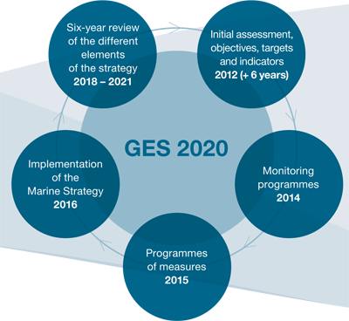
MSFD – Marine Strategies [2]
Notes:
Adaptive management – every six years

Slide 10
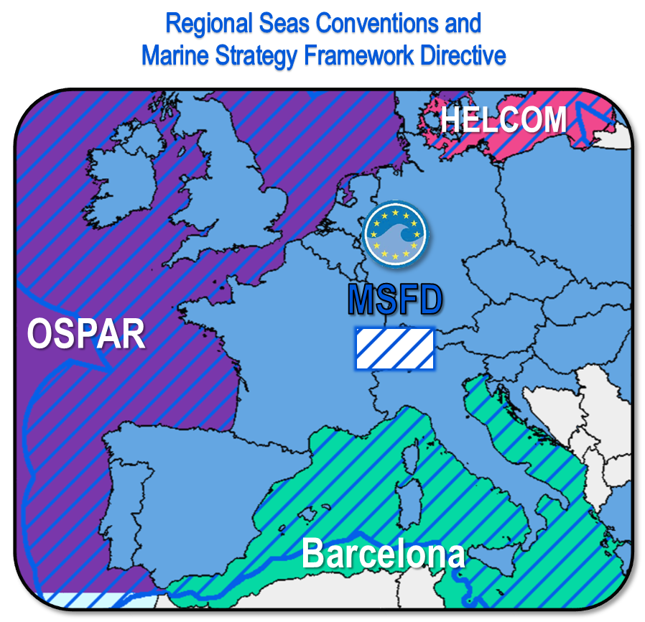
MSFD – Regional Implementation [3]
Four European marine regions
Baltic Sea,
North-east Atlantic Ocean,
Mediterranean Sea and
Black Sea

Slide 11
MSFD - Descriptors [4]
Biodiversity is maintained
Non-indigenous species do not adversely alter the ecosystem
The population of commercial fish species is healthy
Elements of food webs ensure long-term abundance and reproduction
Eutrophication is minimised
The sea floor integrity ensures functioning of the ecosystem
Permanent alteration of hydrographical conditions does not adversely affect the ecosystem
Concentrations of contaminants give no effects
Contaminants in seafood are below safe levels
Marine litter does not cause harm
Introduction of energy (including underwater noise) does not adversely affect the ecosystem
Notes:
As these descriptors cover broad topics, the European Commission produced in 2010 a set of detailed criteria and indicators to help Member States determine what each descriptor means in practice and measure progress.

Slide 12
Water Framework Directive [1]
Objectives:
  Protection of aquatic ecosystems;
  Promotion of sustainable water use based on a long-term protection of available water resources;
  Improvement of the aquatic environment through specific measures for the progressive reduction of discharges, emissions and losses of priority substances and the cessation or phasing-out of discharges, emissions and losses of the priority hazardous substances;
  Reduction of pollution of groundwater, and,
  Mitigation of the effects of floods and droughts.

Slide 13
Water Framework Directive [2]
Aim is to prevent the deterioration of ecological quality and the restoration of polluted surface and groundwaters by the end of 2015
Implemented through River Basin Management Plans
River basins which cross national frontiers must be assigned to an international River Basin District (RBD)
Addresses inland surface waters, estuarine and coastal waters and groundwater.
Notes:
all water management will be based on the natural unit of river basins. objective of river basin projects is to establish an integrated monitoring and management system for all waters.
River Basin Management Plan which must be updated and reviewed every six years. Such a plan must include: Mapping and identification of protected areas; Map of monitoring networks and presentation in map form of monitoring results carried out for surface water, groundwater and protected areas; List of environmental objectives; Summary of economic analysis of water use;
Summary of the public information and consultation measures taken, their results and the changes to the plan made as a consequence; A list of the competent authorities; and ccontact points and procedures for obtaining background documentation and information.
A River Basin District must include coastal/marine waters up to one nautical mile beyond the baseline from which territorial waters are measured.

Slide 14
Water Framework Directive [3]
Transitional waters = estuarine waters, precise technical details for characterisation set out in Annex II;
Coastal waters defined as “surface water on the landward side of a line, every point of which is at a distance of one nautical mile on the seaward side from the nearest point of the baseline from which the breadth of territorial waters is measured, extending where appropriate up to the outer limit of transitional waters.”
Note definition of coastal waters
How will this align with MSFD and MSP? Local specificity?

Slide 15
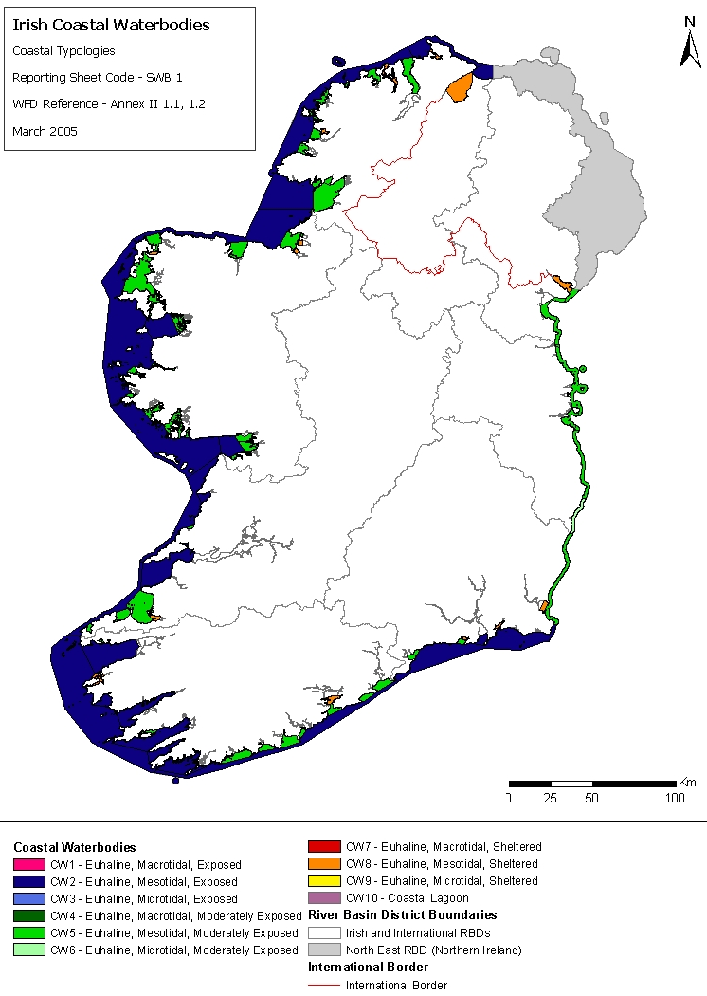
Coastal waters must be assigned to the nearest or most appropriate river basin district or districts;
Member States are obliged to appoint an authority responsible for applying the rules of the Directive within each RBD.

Slide 16
Common Fisheries Policy [1]
Four main pillars
Fisheries Management e.g. Technical Conservation Measures, Total Allowable Catch (TACs)
Structural Policy: funds for infrastructure and fleet (e.g. EMFF)
Market and Trade Policy: consumer information (labelling), pricing,
External Policy: international agreements, access to waters
Also separate rules on Aquaculture and Stakeholder Involvement (Advisory Councils)
Notes:
CFP aims to promote aquaculture through an open method of coordination: a voluntary process for cooperation based on Strategic Guidelines and Multiannual national strategic plans identifying, common objectives and, where possible, indicators to measure progress towards these goals.

Slide 17
Common Fisheries Policy [2]
Reform package sought to boost aquaculture production
EC published the Strategic Guidelines for the sustainable development of EU aquaculture (2013)
Four priority areas identified:
  Reduce administrative burdens
  Improve access to space and water
  Increase competitiveness
  Exploit competitive advantages due to high quality, health and environmental standards
Member States requested to produce Multi-annual National Strategic Plans to promote aquaculture
27 Plans produced
Notes:
CFP aims to promote aquaculture through an open method of coordination: a voluntary process for cooperation based on Strategic Guidelines and Multiannual national strategic plans identifying, common objectives and, where possible, indicators to measure progress towards these goals.

Slide 18
EU Strategic Guidelines on Aquaculture [1]
Multi-annual National Strategic Plans
Member States encouraged to define their own national targets based on their:
Current positions,
National circumstances and
Institutional arrangements.
Four priority areas:
Administrative procedures
Coordinated spatial planning
Competitiveness and
A level playing field
Challenges identified at MS level
Marine:
Lack of available space in inshore, sheltered waters
Complex administrative procedures
Competitiveness of products
Use of Research & Development outputs
Environmental conditions
Freshwater:
Credit, investments and costs
Fragmented structure of sector
Lack of available space
Notes:
Launched in 2013.
Plans must include the Member States' objectives until 2020 and beyond, and the funding, administrative and other measures to be pursued to achieve them.
Administrative complexity stems from the number of ministries involved, the different national and regional regulatory requirements impacting aquaculture activities based on national transposition of WFD, MFSD, Bird and Habitat Directives, and the lack of communication between ministries and authorities on aquaculture issues.

Slide 19
EU Strategic Guidelines on Aquaculture [2]
Exercise
Critique your National Strategic Plan for Aquaculture
Possible considerations:
  Links to other regulatory frameworks
  Approaches to spatial planning
    Recommended tools?
  Environmental monitoring
  Mention of EAA
Is their scope to include EAA in total/part?
  Barriers
  Opportunities
Notes:
CFP aims to promote aquaculture through an open method of coordination: a voluntary process for cooperation based on Strategic Guidelines and Multiannual national strategic plans identifying, common objectives and, where possible, indicators to measure progress towards these goals.

Slide 20
Impact Assessment: SEA, AA and EIA

Slide 21
Impact Assessment
Needs to answer:
  what the problem is,
  what the objectives to be pursued are,
  what the options are,
  what their possible impacts are and
  how the options compare.
Must ensure the balanced assessment of economic, environmental and social impacts of proposals and avoid unintended and unexpected side effects.

Slide 22
Types of Impact Assessment
SEA | EIA | Appropriate Assessment
Strategic level | Site level | Natura 2000 site and its conservation objectives
Takes place at early stages of decision-making cycle: aims to prevent impacts | Takes place near the end of decision-making cycle: aims to minimise impacts | Takes place early in the process (screening)
Emphasis on meeting environmental objectives, maintaining natural systems | Emphasis on mitigating and minimising impacts | Emphasis on possible nature conservation implications of any plan or project on Natura 2000 site
Broad perspective, lower level of detail | Narrow perspective, high level of detail | High level of detail specific to site

Slide 23
Strategic Environmental Assessment (SEA) Directive [1]
Involves the systematic identification and evaluation of the impacts of a strategic action (e.g. a plan or programme) on the environment
ALSO the effects of the environment on the PPs
Operates in conjunction with the EIA Directive
Still uncertainty around what plans and programmes are subject to SEA.... does apply across a wide range of sectors
Notes:
Adopted in 2001 PUBLIC plan or programme (not policy)
23

Slide 24
SEA Directive [2]
Prepare an Environmental Report - likely significant environmental effects are identified and evaluated
Consult the public, environmental authorities and any MS affected on the ER and draft P/P
Take account of the findings of the ER and the outcome of the consultations in deciding whether to adopt or modify the draft P/P
Make known the decision on adoption of the P/P and how SEA influenced the outcome.

Slide 25
SEA Directive [3]
Environmental Report
  Contains the likely significant effects on the environment of implementing the PP
  Reasonable alternatives
Significant effects on the environment
  Issues and their interrelationships
Environmental objectives
  How does the PP take conservation objectives in the area into account
Notes:
Where an environmental assessment is required under Article 3(1), an environmental report shall be prepared in which the likely significant effects on the environment of implementing the plan or programme, and reasonable alternatives taking into account the objectives and the geographical scope of the plan or programme, are identified, described and evaluated. CONSULTATION then decision. Monitoring. Measures to prevent, reduce and as fully as possible offset any significant adverse effects on the environment of implementing the PP
Issues such as biodiversity, population, human health, fauna, flora, soil, water, air, climatic factors, material assets, cultural heritage, landscape and the interrelationship between the above factors
25

Slide 26
Nature Conservation: Birds and Habitats Directives and Biodiversity Policy

Slide 27
Birds Directive (2009/147/EC)
Seeks to protect, manage and regulate all bird species naturally living in the wild within the European territory of the Member States, including the eggs of these birds, their nests and their habitats
193 endangered species and sub-species
Requirement to designate Special Protection Areas (SPAs) on land or at sea (Wetlands of particular importance)
Requires the avoidance of pollution or deterioration of habitats generally, outside SPAs
May require the prevention or control of activities on, near or in an area which is the habitat of a protected bird
Notes:
500 species in the EU
Detailed provisions on hunting, capturing and trading of birds.
Annex 1 lists species that are particularly threatened and for which SPAs are to be created.

Slide 28
Levels of Protection in Birds Directive
Annex 1: 194 species and sub-species are particularly threatened. Member States must designate SPAs for their survival and all migratory bird species.
Annex 2: 82 bird species can be hunted. Hunting periods are limited and forbidden when birds are at their most vulnerable
Annex 3: generally, activities that directly threaten birds, are banned. With certain restrictions, Member States can allow some of these activities for the 26 species listed in this Annex.
Annex 4: the Directive provides for the sustainable management of hunting but Member States must outlaw all forms of non-selective and large scale killing of birds, using the methods listed in this Annex.
Annex 5: the Directive promotes research to underpin the protection, management and use of all species of birds covered by the Directive, which are listed in this annex.
Notes:
Hunting forbidden during their return migration to nesting areas, reproduction and the raising of their chicks.
Annex 3 - such as their deliberate killing, capture or trade, or the destruction of their nests

Slide 29
Habitats Directive (92/43/EEC)
Preamble – to ensure “the restoration and maintenance of natural habitats and species of Community interest at favourable conservation status.”
Objective: ‘To contribute towards ensuring biodiversity through the conservation of natural habitats and of wild fauna and flora in the European territory of the Member States to which the EC Treaty applies’ (Art. 2(1))
Seeks to ensures the conservation of a wide range of rare, threatened or endemic animal and plant species
  1000 animal and plant species
  200 habitat types
Requirement to designate Special Areas of Conservation (SACs) on land or at sea
Notes:
Irish habitats include raised bogs, blanket bogs, turloughs, sand dunes, machair (flat sandy plains on the north and west coasts), heaths, lakes, rivers, woodlands, estuaries and sea inlets. There is also a list (Annex II) of species which must be afforded protection and for Ireland this includes the Bottle-Nosed Dolphin, Otter, Freshwater Pearl Mussel and Killarney Fern.
Generally economic development prevails over conservation interests

Slide 30
Levels of Protection in Habitats Directive
Annex II species (about 900): core areas of their habitat are designated as sites of Community importance (SCIs) and included in the Natura 2000 network. These sites must be managed in accordance with the ecological needs of the species.
Annex IV species (over 400, including many Annex II species): a strict protection regime must be applied across their entire natural range within the EU, both within and outside Natura 2000 sites.
Annex V species (over 90): Member States must ensure that their exploitation and taking in the wild is compatible with maintaining them in a Favourable Conservation Status.

Slide 31
Natura 2000 Network
Largest coordinated network of protected areas in the world
Aim is to ensure the long-term survival of Europe's most valuable and threatened species and habitats
Not a system of strict nature reserves
Management Plans may be drawn up for designated sites
Duty on Member States to avoid deterioration of habitats and significant disturbance of species
Also have to establish the standards to be applied to consideration of development proposals potentially threatening any sites
Notes:
over 18 % of the EU’s land area and almost 6 % of its marine territory
Designation does not exclude all human activities

Slide 32
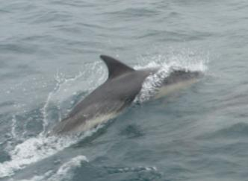
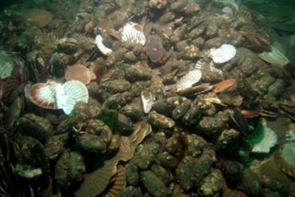
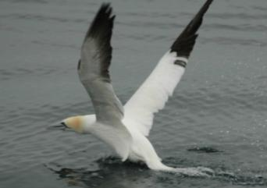
Impact of Designation
Designation does not exclude all human activities
Developments likely to have an adverse effect on a Natura 2000 site must be subject to an Appropriate Assessment in light of the site’s conservation objectives
Developments must have no significant effects on the integrity of a designated site considering the
  Site structure,
  Function and
  Conservation objectives.
Notes:
Developments must not cause any significant damage or disturbance to species of Community interest (i.e. those covered by the Directives) or their key habitats in the broader countryside.
Habs Dir requires that a plan or project having a likely significant negative effect on a Natura 2000 site undergoes an ‘Appropriate Assessment’ to study these effects in detail and to see how they relate to the site’s conservation objectives.
Depending on the findings of the Appropriate Assessment, the competent authority agrees to the plan or project as it stands if it has ascertained that it will not adversely affect the integrity of the site concerned.

Slide 33
Appropriate Assessment* Process
* HRA in the UK

Slide 34
Environmental Impact Assessment Directive [1]
Introduced in 1985
  Amended in 1997, 2003 and 2009
  Codified in 2011
  Amended in 2014
Requires an assessment of the environmental impact of any project likely to have significant effects on the environment before consent can be granted
  Annex I
  Annex II
Other Member States must be consulted about proposals that are likely to have a transboundary effects.
Notes:
Any project = public and private
Needs to cover nature, size and location of development. Also needs to cover potential impact of plans and projects in all sectors not just offshore wind (including, for example, coastal inshore wind farms, aggregate extraction, dredging and disposal of dredged material, shipping, oil and gas exploration and production). EC guidance defines cumulative impacts as “impacts that result from incremental changes caused by other past, present or reasonably foreseeable actions together with the project”. (Hyder 1999)
34

Slide 35
EIA Directive [2]
Developer may request the competent authority to say what should be covered by the EIA (scoping stage);
Developer must provide information on the environmental impact (EIA report – Annex IV);
The environmental authorities and the public must be informed and consulted;
The competent authority decides, taking into consideration the results of consultations;
The public is informed of the decision afterwards and can challenge the decision before the courts.

Slide 36
EIA Directive [3]
Project preparation
Environmental studies: baseline and impact analysis
Consultation with statutory environmental authorities, other interested parties and the public
Notification to competent authority
Submission of env. information to competent authority
Consideration of environmental information by competent authority before making final decision
Screening
Review of adequacy of env. information
Scoping
Announcement of decision
Post-decision monitoring if project is granted consent
[Coloured stages are covered explicitly by Directive]
Source: ERM, 2001

Slide 37
EIA Directive [4]
What should an EIA do?
What type of information should be included?
Note changes in legislation (Directive and transposing instruments)
What type of effects should be covered?
How are cumulative impacts dealt with?
How is monitoring dealt with?

Slide 38
Summary
SEA | EIA
Takes place at earlier stages of decision-making cycle: aims to prevent impacts | Takes place near the end of decision-making cycle: aims to minimise impacts
Pro-active approach to development proposal | Reactive approach to development proposal
Considers broad range of potential alternatives | Considers limited number of feasible alternatives
Emphasis on meeting environmental objectives, maintaining natural systems | Emphasis on mitigating and minimising impacts
Broad perspective, lower level of detail to provide a vision and overall framework | Narrow perspective, high level of detail

Slide 39
Differences between Assessments
 | EIA | AA
Development type? | All projects in Annex I, discretionary for Annex II projects. | Any development likely to have an adverse effect on a Natura 2000 site.
Impacts to be assessed? | Direct and indirect, secondary, cumulative, short, medium and long-term, permanent and temporary, positive and negative significant effects. | Assessment should be made in view of the site’s conservation objectives (which are a function of the species/ habitat types for which the site was designated).
Done by? | The developer. | The Competent Authority (with developer input).
Outcomes? | Results must be taken into consideration in the development consent procedure. | Binding. Competent authorities can agree to the development only after having ascertained that it will not adversely affect the integrity of the site.

Slide 40
Suggested Exercise
Facilitated discussion on current planning and management frameworks covering topics such as:
Strategic aquaculture policy (presence/absence?
SWOT Analysis of existing legal framework
  What impacts positively on the sector?
  What impedes development?
  Attention should be paid to whether these derive from international/EU/national law or administrative processes
Theory v. practice
How is monitoring dealt with?
Enforcement and compliance aspects

Slide 41

For more information about
the AquaSpace CPD Course
and spatial planning toolbox,
visit our website:
www.aquaspace-h2020.eu
The materials used here have been assembled as part of the AquaSpace project
(Ecosystem Approach to making Space for Aquaculture, http://aquaspace-h2020.eu)
and has received funding from the European Union's Horizon 2020 Framework Programme
for Research and Innovation under grant agreement n° 633476.
Horizon 2020

