Slide 1
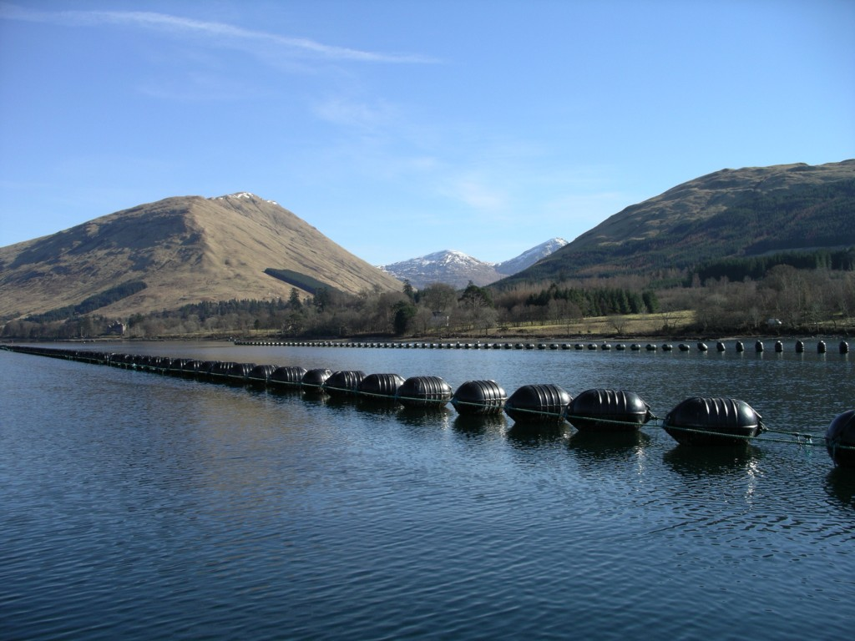
AquaSpace Case Study Békés County, Hungary: Issues and Tools
The research leading to these results has been undertaken as part of the AquaSpace project (Ecosystem Approach to making Space for Aquaculture, http://aquaspace-h2020.eu) and has received funding from the European Union's Horizon 2020 Framework Programme for Research and Innovation under grant agreement n° 633476.
Horizon 2020

Slide 2
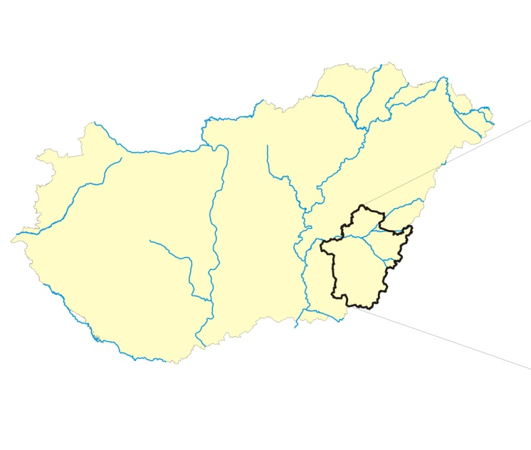
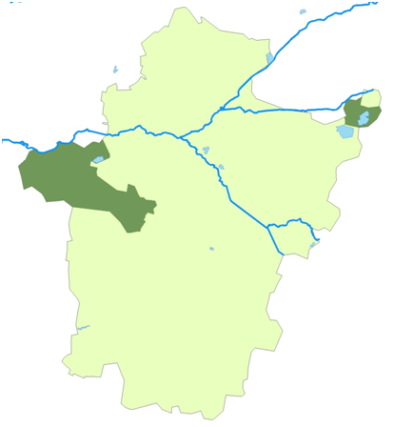
Where?
Analysis of the impact of spatial issues on AQ development in freshwater environment (WP2&WP4)
Stakeholder opinions on barriers to growth (questionnaire, workshop)

Slide 3
Case study ISSUE
«Spatial planning and management issues”
The main pond system is situated in the surroundings of the village Biharugra, which is the second largest fish pond system (1927 ha) in Hungary.
The major species produced in Bekes is common carp, followed by tank-based production of African catfish.
Development trends in freshwater pond culture are moving towards sustainable intensification
Multi-annual national strategies involve a plan for:
maintaining the current pond area for extensive aquaculture and strengthening its ecosystem services (habitat provision, microclimatic effects, landscape formation),
modernization of existing production units (development and purchase of new technologies),
diversification of the aquaculture sector in terms of produced species (with high market potential) and activities (multi-functionality, angling, ecotourism),
knowledge transfer, exchange of best practices at the national level and also between MS,
development of the post-harvest value chain and boosting the demand for freshwater products.

Slide 4
Case study ISSUE
The most important issues
Ecosystem services
Conflicts between natural conservation and aquaculture producers - damage caused by predatory animals
Proper site selection tools are missing
National implementation of Water Framework Directive, Habitat Directive and Bird Directive how do influence aquaculture production in HU, CZ, PL (WP2)
EAA: Lack of integrated watershed management (surface and subsurface water use, waste water treatment/disposal, urban runoff, excess water, draft etc.)
Legal uncertaincy i.e. not clearly defined the priority in water use

Slide 5
Tools used in the case study
GIS mapping-site selection method
Databases-site selection method, valuation of ecosystem services
Biophysical and sociocultural valuation of ecosystem services

Slide 6
Tools used in the case study
GIS mapping-suitable sites selection

Slide 7
Tools used in the case study
Databases-site selection method, valuation of ecosystem services
 | Data requests | Available data from General Directorate of Water Management | Other data sources | Format
1 | Spatial and temporal variability of the water use in ponds | Fish-farm water abstractions in the year 2013 (according to the statistical data of water users in general total water per year, sometimes monthly breakdown) for Békés county or bodies of water catchments concerning the Békés county. |  | excel
2 | Spatial and temporal distribution of drained waters | For the ponds drainage, the amount of used water is drained to the surface water bodies in the year 2013 (according to the statistical data of water users in general total water per year, sometimes monthly breakdown) for Békés county or bodies of water catchments concerning the Békés county. |  | 2 excel tables
3 | Drained water quality indicators of the ponds (N, P, COD, turbidity or suspended matter) | http://www.vizugy.hu/index.php?module=vizstrat&programelemid=149 | Current data from Disaster Management Directorate in Békés county | excel
4 | Location of the ponds | Primarily GIS overlay of fish still waters for economic purposes 2015th data updated in April, Békés County |  | shape
5 | Surface water resources | Rate of August runoff and multi-annual average of norma stream flow and those water bodies which relate to the water distribution of the Szarvas district in Békés county |  | shape
6 | Spatial and temporal variability of surface waters | Daily or monthy data of water flow measuring stations in Békés county | Concerning Water Management Directorate
7 | excess water hazardous area map | Inland excess water risk map- ÖVKI
8 | Spatial and temporal distribution of excess water | The drainage amount from the area of excess water -Water Management Directorate
9 | Flood risk
10 | Drought risk
11 | River water bodies | National geodatabase |  | geodatabase
12 | Standing water bodies | National geodatabase |  | geodatabase

Slide 8
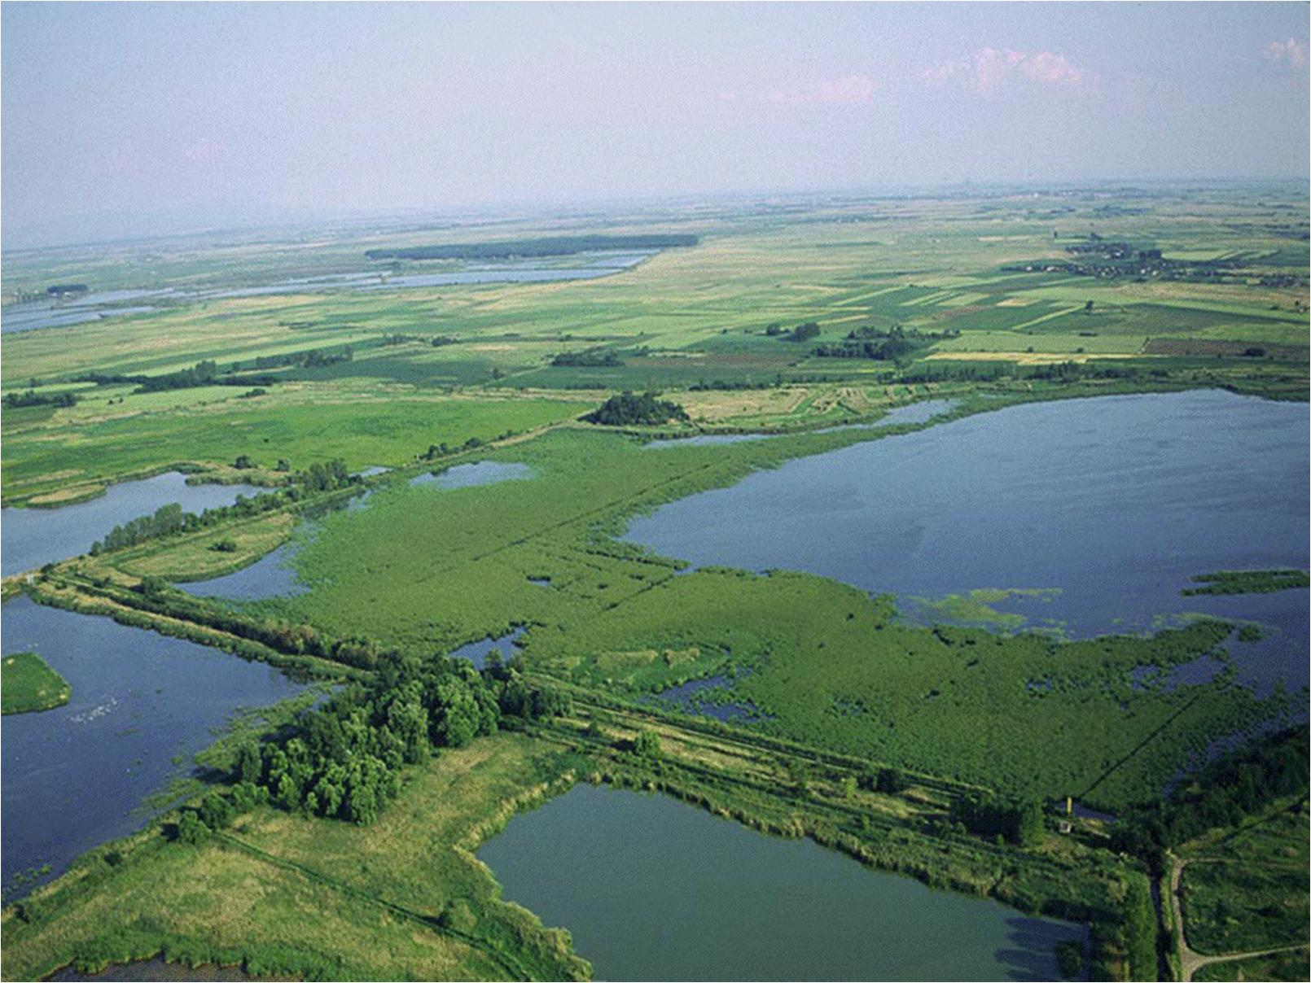
Tools used in the case study
Biophysical and sociocultural valuation of ecosystem services
Importance of ES given by local inhabitants (1-5) n=71
Ecosystem service | Average
Habitat | 5,0
Environmental education | 4,6
Food (fish) | 4,4
Recreation, ecotourism | 4,4
Landscape value | 4,3
Reed | 4,1
Climate regulation | 4,0
Artistic inspiration | 3,8
Research | 3,8
Material for crafts | 3,4
Water treatment | 3,4
Water regulation | 3,3

Slide 9
Stakeholder feedback
1st stakeholder workshop (January 2016) with 55 attendants
important milestone in the consultation process among the representatives of different sectors
industry, authorities, national park, NGO, academic institutes, local and national decision-makers
to gather different stakeholders and discuss current constrains was a breakthrough activity and was assessed very positively. The continuation of the consultation and seeking jointly the solution for the concerns is a significant option to support the aquaculture sector.
The most important issues
Ecosystem services
Conflicts between natural conservation and aquaculture producers - damage caused by predatory animals
Regulation on water service fee
2nd stakeholder workshop is planned
to present case study results and get feedback in March 2017

