Slide 1
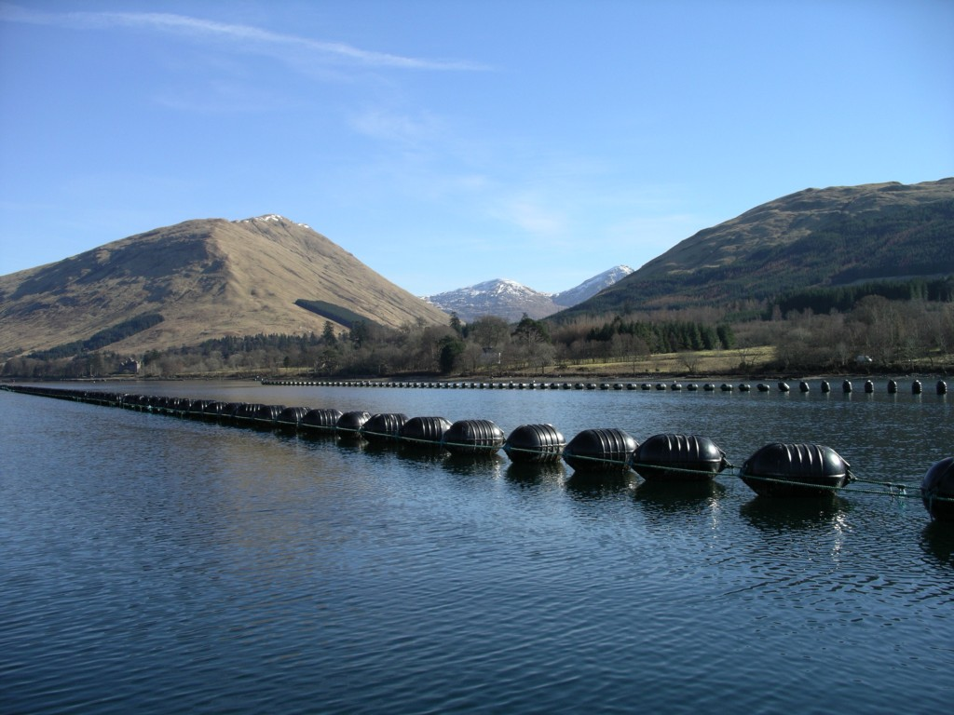
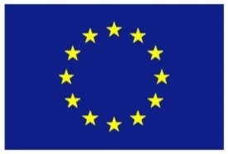
AquaSpace Case Study Mediterranean Sea, Multiple EEZ: Issues and Tools
The research leading to these results has been undertaken as part of the AquaSpace project (Ecosystem Approach to making Space for Aquaculture, http://aquaspace-h2020.eu) and has received funding from the European Union's Horizon 2020 Framework Programme for Research and Innovation under grant agreement n° 633476.
Horizon 2020

Slide 2
Where?
The Mediterranean can be considered as a miniature of the world
different cultures
different levels of economic growth
different administrative styles,
different economic priorities and technical capabilities
But
all share the same volume of water, a common history
and the need to feed a growing population
Mediterranean fish cage farming
21,000 fish farms
fin fish production >200,000 mt
leading countries Greece, Turkey and Spain
The Mediterranean paradigm has to offer important experience in the frames of successful implementation of aquaculture policy and management in a multinational area.
Notes:
One map
Two bullet points on relevance to AquaSpace

Slide 3
Case study ISSUE
Although the already established guidelines and recommendations from previous projects and initiatives (IUCN, FAO-GFCM) set a good basis for establishing good practice principles, harmonization and review on the efficiency of the framework is needed.
In the frames of this CS the below mentioned issues are confronted:
Follow up and evaluation of IUCN, ICZM and AZA (as propsed by FAO GFCM) concept application in different Mediterranean Countries.
Evaluating methods, indicators, and environmental standards used in the frames of the European Directives (WFD and MSFD) for monitoring aquaculture activities in different countries.
Other factors (economic depresion, war conflicts etc.) preventing the expansion of Mediterranean aquaculture.
Notes:
Condensed description of the updated «Spatial planning and management issues”
The most important issues in maximum 3 bullet points
How the case study at national level relates to EU- policy framework (like the MSP directive and others) and EAA framework

Slide 4
Tools used in the case study
Existing and historical fish cages locations extracted from Google Earth (issue with varying resolution but the provided images are updated and improved in comparison with the study of Trujillo et al. (2012).
Depth data were collected from Emodnet portal (http://www.emodnet.eu/bathymetry).
We used ArcGis to extract values from a GRID file to point locations and assigned depth values from the nearest cage were there was no satellite information.
Data processing and map projection was carried out using R program language (R Core Team 2017) and packages "maps", "marmaps" and "shape".
Notes:
Including issues addressed by applying those tools...

Slide 5
Aquaspace tool
Mapping of the Mediterranean fish cage farms and recognizing the existing diversity among Mediterranean countries in terms of the aquaculture regulatory frameworks and production policies.
Example: Greece vs Turkey
In both countries AZA concept adopted since 2009 and 2006 respectively but implemented in a different way (“POAY” in Greece, designated offshore sites in Turkey)
110kt fish
202 fish farm clusters
75kt fish
103 farm clusters
Notes:
Here we show the current state of marine fish farms in the higher production mediterranean countries (Greece and Turkey)
The adaptation of the AZA concept in the regulations was made differently in the two countries.
In Turkey the aquculture zones were concentrated only in small part of the coastline (in protection of tourism industry) and moved offshore. Thus the fish farms were required to move a minimum distance from the land of 0.6 miles and the minimum depth of 30 meters.
For Greece the aquaculture zones were distributed along the coastline. The spatial planning of the fishfarms is based on the carrying capacity of the installation area, determined by parameters such as distance from shore, depth and currents.

Slide 6
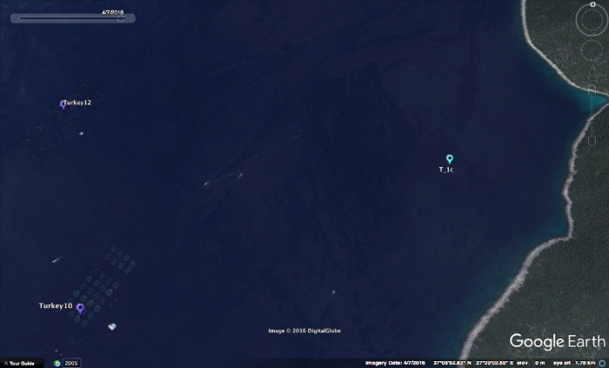
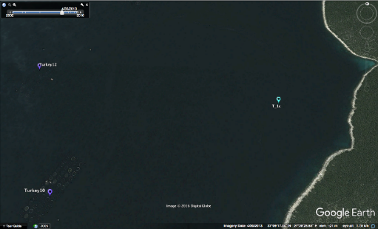
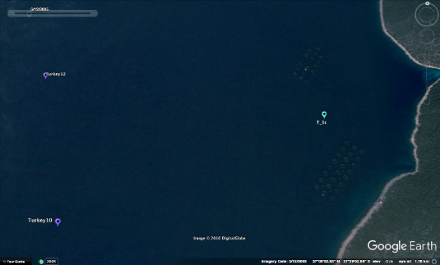
Aquaspace tool
Mapping of current and historical data of the Mediterranean fish cage farms and recognizing the existing diversity among Mediterranean countries in terms of the aquaculture regulatory frameworks and production policies.
Measured time points: Period 1: 2006-2009, Period2: 2010-2013, Period 3: 2014-2017
Measured parameters:
Distance from the shore (meters)
Depth (meters)
Spatial distribution between fish farms (meters)
Fish Cage size (meters)

Slide 7
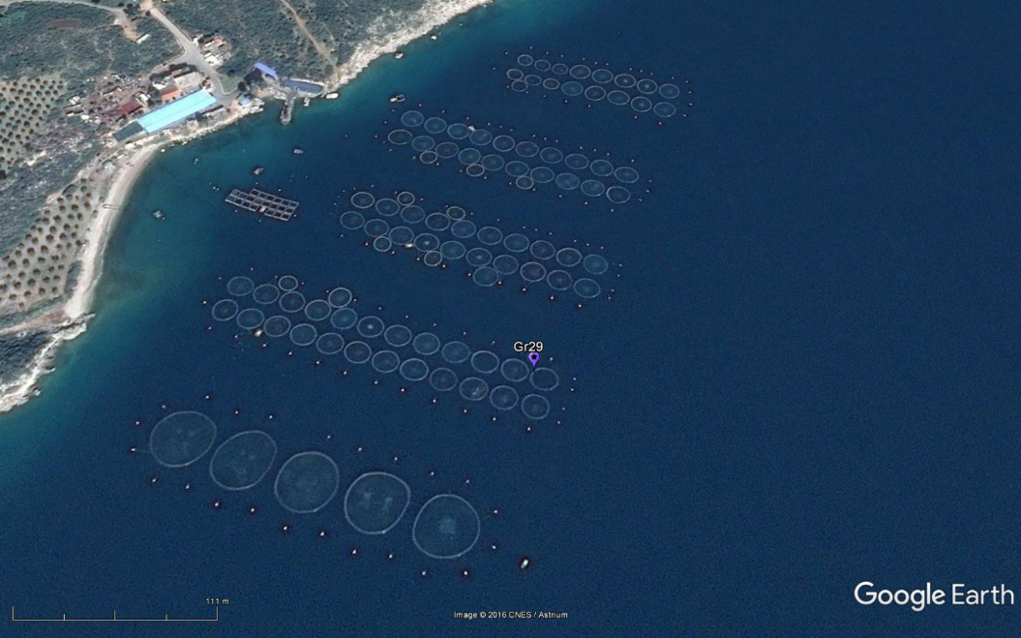
Aquaspace tool
Mapping of current and historical data of the Mediterranean fish cage farms and recognizing the existing diversity among Mediterranean countries in terms of the aquaculture regulatory frameworks and production policies.
Measured parameters:
Distance from the shore
Depth
Spatial distribution between fish farms
Fish Cage size

Slide 8
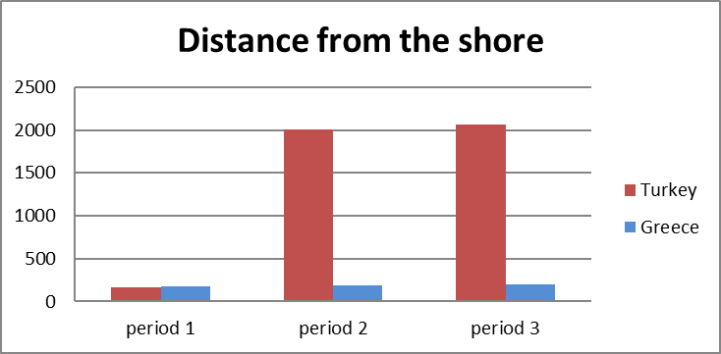
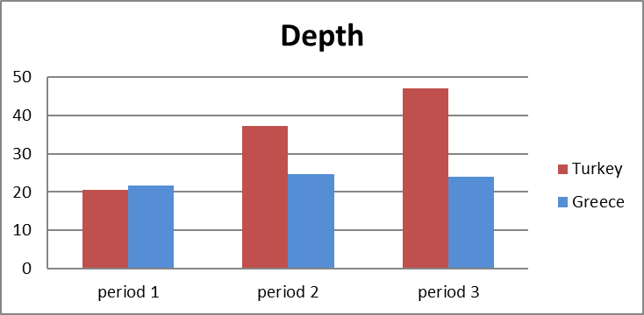
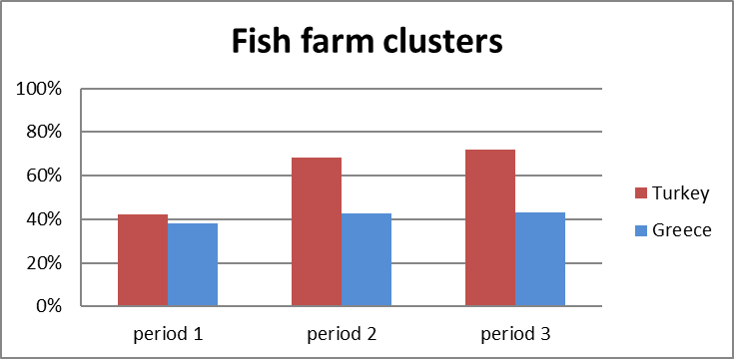
Aquaspace tool
Evaluation of the AZA concept adoption in Greece and Turkey: spatial distribution
Notes:
In Greece the distance from the shore has not changed significantly between periods. In Turkey the distance from the shore was increased in accordance to the new regulations. The same with depth.
The fish farms tend to aggregate in clusters in Turkey, in Greece the distribution of the fish farms is much more scarce and on;y the 40% of the fish frms in aggregated in larger clusters.

Slide 9
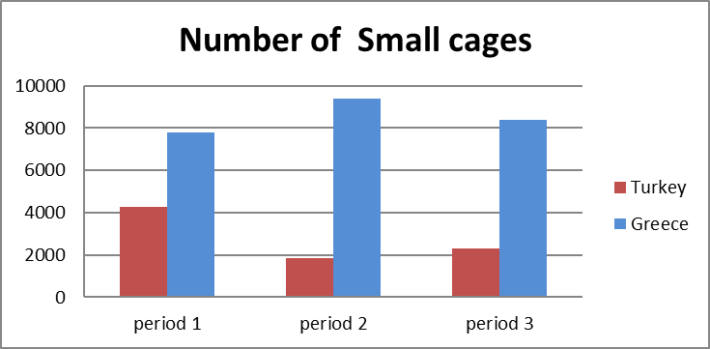
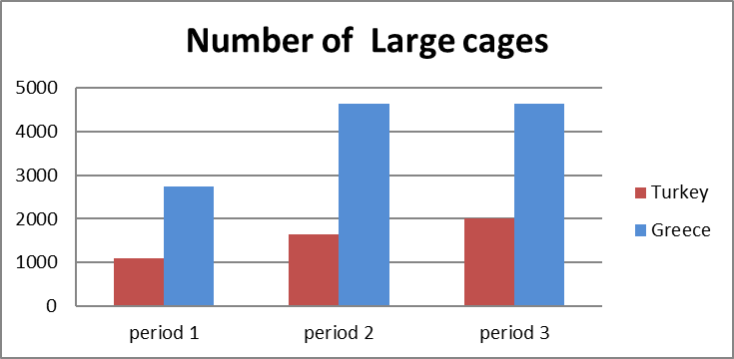
Aquaspace tool
Evaluation of the AZA concept adoption in Greece and Turkey: production and performance
In Greece the adoption of AZA concept provided the industry with a boost in production but the expansion of the industry is currently hindered due to other factors.
In Turkey the adoption of the AZA concept provided the industry with a sufficient boost and it seems that the expansion will continue but the biggest part of the market is occupied by bigger companies.
Notes:
In Greece the cage numbers have not changed significantly between periods 2 and 3. There is a small decrease in the number of small cages for Period 3. The number of the large cages has changed significantly between period 1 and 2 which coincides with the adoption of the new aquaculture regulation (increased the allowable fish production carrying capacity in many areas).
In period 3 no increase was recorded possibly due to other external factors like economic depression or declining market prices.
In Turkey the usage of small cages was replaced by larger cages. This can be related with the movement of the fish farms in deeper and more exposed areas but I can be also caused by another factor: small fish farm owners could not cope with the demands of the new regulations (new technologies, new location and finding/ economic/ support) and as a result 166 farms were closed and only the large companies could successfully make the transfer to the new regulation regime.

Slide 10
Stakeholder feedback and recommendations
The MSP description and framework at national level is not implemented in the most of the Mediterranean countries.
IUCN and ICZM concepts are embedded in most Countries
AZA adopted in a number of countries
except of spatial reasons a number of policy and economic factors limits aquaculture expansion
Notes:
In bullet points

