Slide 1
Topic 12: Discussion of Spatial Planning for Aquaculture
Masters Module
PLANNING AND MANAGING THE USE OF SPACE FOR AQUACULTURE
Paul Tett SAMS
Ibon Galparsoro AZTI
26 September 2018
The materials used here have been assembled as part of the AquaSpace project (Ecosystem Approach to making Space for Aquaculture, http://aquaspace-h2020.eu) and has received funding from the European Union's Horizon 2020 Framework Programme for Research and Innovation under grant agreement n° 633476.
They may be used under a Creative Commons Attribution-ShareAlike 4.0 International License, with attribution to the author
Horizon 2020

Slide 2
Introduction
These slides contain the diagrams used in a Discussion of Spatial Planning for Aquaculture in the context of the Aquaspace project
Details of references can be found in the accompanying text by Tett, P. & Galparsoro, I. (2018) Discussion of Spatial Planning for Aquaculture, AquaSpace project, SAMS, Oban, Scotland.

Slide 3
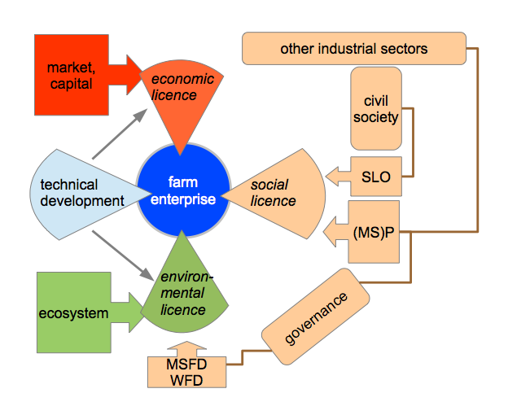
Three Licences Licences are switches that must by ‘ON’ for the enterprise to be viable; in some cases they are legal permissions
(MS)P: (Marine Spatial) Planning;
SLO: Social Licence to Operate;
MSFD: Marine Strategy
Framework Directive (2008/56/EC);
WFD: Water Framework
Directive (2000/60/EC)

Slide 4
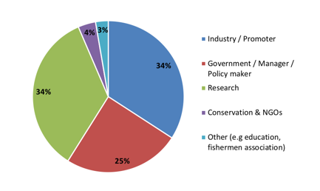
Stakeholders
Categorization of stakeholders attending AquaSpace workshops, from Galparsoro et al. (2018)

Slide 5
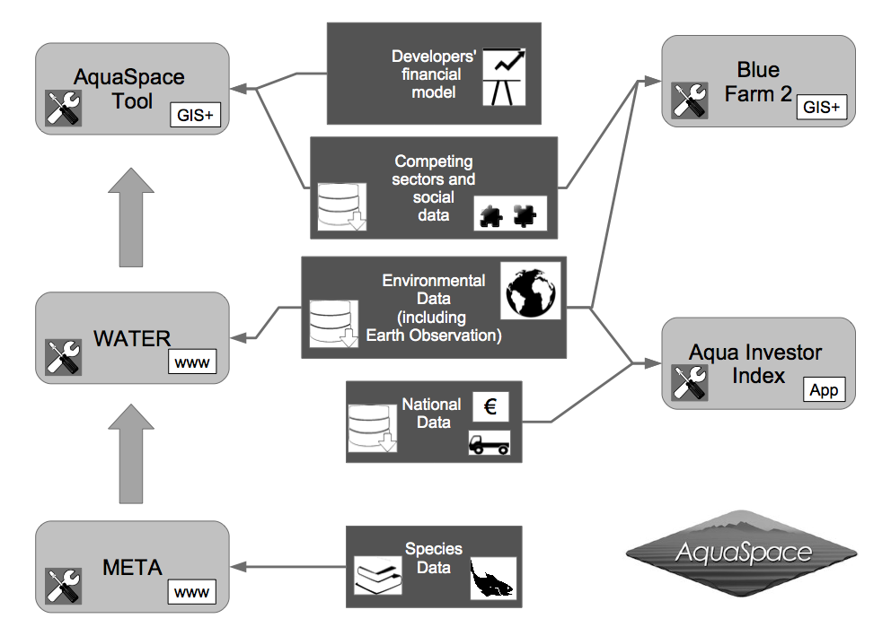
AquaSpace Integrating Tools

Slide 6
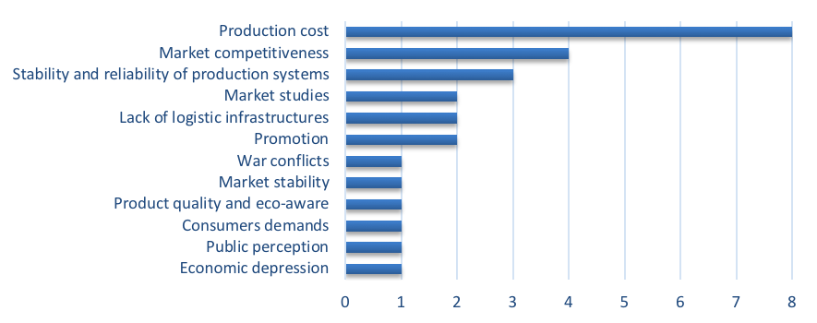
Economic Issues
Frequency of reported issues with an economic and market dimension: number of AquaSpace study sites out of maximum 17, from Galparsoro et al. (2018).

Slide 7
Action Situation
Ostrom's Action Situation diagram (Ostrom, 2007, fig. 1) modified to describe
the licence-related interactions that have been considered in this unit.
The bounded social-ecological system implied by this diagram should be viewed as dynamic,
evolving over time as a result of internal processes and the effects from outside of
environmental pressures and economic and social drivers.

Slide 8
For more information about
the AquaSpace Masters module
and spatial planning toolbox,
visit our website:
www.aquaspace-h2020.eu
The materials used here have been assembled as part of the AquaSpace project (Ecosystem Approach to making Space for Aquaculture, http://aquaspace-h2020.eu) and has received funding from the European Union's Horizon 2020 Framework Programme for Research and Innovation under grant agreement n° 633476.
Horizon 2020

